Slide 1
fitUnited Pittsburgh
Serving Allegheny, Westmoreland, Fayette and southern Armstrong Counties
Healthy Meals Home Delivery
Grantmakers of Western Pennsylvania
August 3rd, 2016

Slide 2
The Opportunity
In Allegheny County
14.4% Food Insecurity Rate
18.8% Child Food Insecurity Rate
Undernourished children are at risk of serious health, social and educational problems carrying into adulthood
In our underserved communities or areas with LSA (low supermarket access) this is more pronounced:
56.4% of children in Braddock are living in poverty
Braddock median household income: $22,924
Significant numbers of children in underserved communities are looked after by unregulated childcare providers classified as Relative/Neighbor providers

Slide 3
The Opportunity (cont.)
Home-based child care providers in underserved communities face a number of challenges in providing healthy foods for children in their care:
Storage and Time: shopping and storing food in a residential facility can be a challenge
Lack of Participation in State Administered programs: very few Relative/Neighbor providers participate in CACFP (Child and Adult Care Food Program)
Cost: those who do participate in CACFP report they spend more than the allowance.
In Pennsylvania 5,300 children that we know of are cared for by Relative/Neighbor Providers
825 (or 15.5%) of those are in Allegheny County
2,214 (41.7%) are in Philadelphia

Slide 4
Relative/Neighbor Provider Profile Ellen Lomax
A Grandmother living in Braddock PA
Cares full time for 2 of her grandchildren
Ms Lomax does not have a car, and has physical mobility issues
When we first met Ms Lomax, she was saving up to get the $12 she needed for the jitney to take her to the supermarket
She uses coupons which often dictate which store she shops at – and she tries to keep her pantry stocked with shelf-stable items in case she has trouble getting the jitney money together
We were Ms Lomax’s only means of support during the pilot, and she often talked to us about troubles she was having unrelated to food and nutrition

Slide 5
The Opportunity (cont.)
Relative/Neighbor Providers
Receiving Child Care Subsidies based on eligibility of parents
They qualify for CACFP but few participate
Caring for children in an unregulated and unmonitored environment – no assessment of:
Safety
Air quality
Programming
Nutrition
November 2016 they will need to be certified, but only if looking after unrelated children

Slide 6
Our Average Provider
4 Children
Many are providing more than 2 meals and a snack
Only 1/3 of providers were meeting recommended servings of fruits/vegetables
Almost 50% rely on a friend or public transportation to go food shopping
78% cite challenges in accessing food
Average provided less than 1 full serving of fruit/vegetables a day
65% serve fast food to the children

Slide 7
The Solution
Bring fresh, healthy food to the doors of home-based childcare providers
Included key stakeholders in the targeted community of Homewood: Homewood Children’s Village, Greater Pittsburgh Community Food Bank, YMCA and YWCA
Create long-term, sustainable program by using Federal reimbursement dollars
For $22.70, deliver a weeks worth of groceries per child to their door

Slide 8
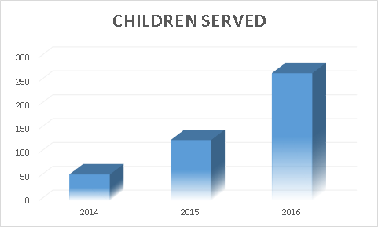
The Solution (cont.)
Significant testing and learning started with our first pilot in 2014
Phase I:
Heinz/Grable/Eat’n Park
Prepared Meals
Homewood
Phase II
Heinz/Grable/Eat’n Park
Groceries
Added Hazelwood
Phase III
Hillman Foundation
Groceries
6 Neighborhoods

Slide 9
The Solution (cont.)
Pilot 1: Summer 2014
Funded by Eat’n Park Hospitality Group, Heinz Endowments, Grable Foundation
Prepared Meals for 55 children in Homewood
Lessons learned incorporated into next pilot
Pilot 2: Summer 2015
Funded by Eat’n Park Hospitality Group, Heinz Endowments, Grable Foundation
Delivered groceries for 127 children in Homewood and Hazelwood
Pilot 3: March 2016
Funded by the Hillman Foundation
Expand to 6 Neighborhoods
267 Children
55 Providers
Homewood, Hazelwood, Braddock, Turtle Creek, Northside,

Slide 10
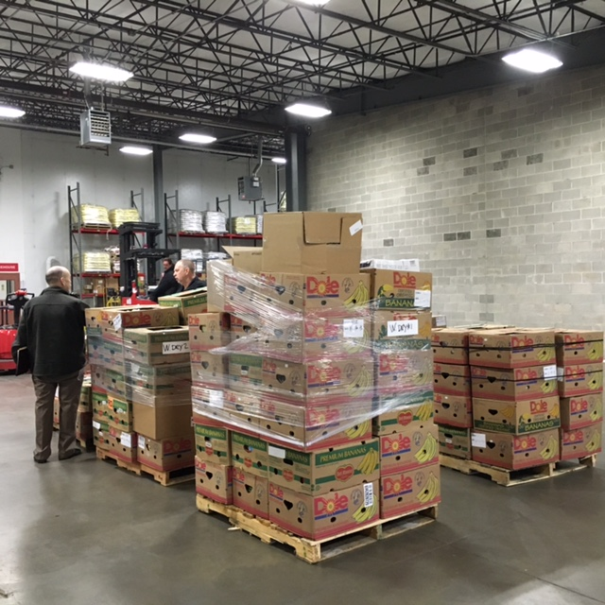
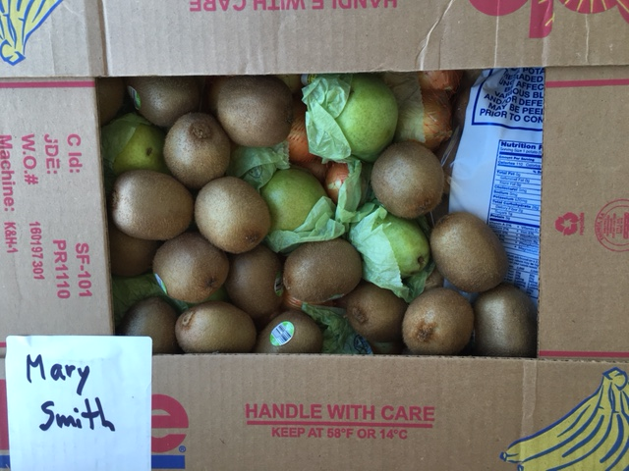
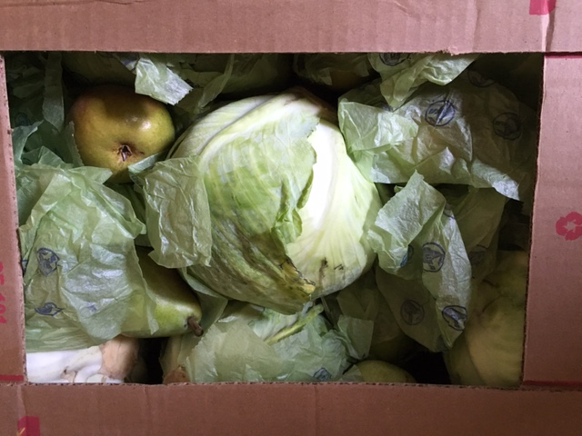
Healthy Meals Home Delivery Phase III
12 week program delivering healthy groceries weekly
55 home-based child-care providers in the North Side, Braddock, Turtle Creek, Homewood, Hazelwood & Wilkinsburg
Serving 267 children every week
Partnering with the Greater Pittsburgh Community Food Bank (procurement and repack), Mission Logistics (delivery), GoShadow (data gathering and optimization tool), PAEYC (identifying childcare providers)
7,500lbs of food - 13,000 individual pieces of fruits and vegetables

Slide 11
Sample Weekly Menu
 | Monday | Tuesday | Wednesday | Thursday | Friday
Breakfast | 1% Milk / Toasted O’s / Canary Melon Slices | 1% Milk / Pancakes / Apple slices | 1% Milk/ Wheat flakes / Banana | 1% Milk/ Oatmeal/ Apple Sauce | 1% Milk/ Scrambled Eggs with whole wheat toast/ Kiwi
Lunch | 1% Milk / Grilled Cheese on whole wheat toast / Carrot soup / Kiwi | 1% Milk / Sticky chicken drumsticks / macaroni and cheese / coleslaw / canary melon | 1% Milk / chicken bean bake with brown rice | 1% Milk / smoked turkey drums / carrot slaw / apple slices / whole wheat toast | 1% Milk / zucchini-carrot patties / brown rice with black beans
Snack | Water / granola bar / apple slices | Water / hard boiled egg / whole wheat toast | Apple / Cinnamon O’s / Orange Juice | Water / Banana with peanut butter | Water / apple / whole wheat toast with peanut butter

Slide 12
Measures of Success
Demonstrate ability to meet or exceed quantities needed per child per week
97% of providers confirmed they had food left over every week
Ensure we are delivering healthy meals for children
82% of providers were providing 2-4 servings of fruits and vegetables during the day (increase from 58% before the program)
Engage Relative/Neighbor Providers in chosen communities
90% of our providers were Relative/Neighbor providers (target 10%)
Ensure the program can be scaled
Add 3 new communities: we added four new communities: Braddock, North Side, Wilkinsburg and Turtle Creek
Provide food for 240 children per week: we were delivering for 267 children every week

Slide 13
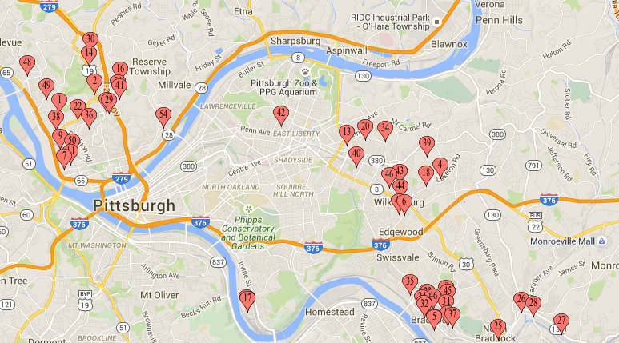
Key Underserved Neighborhoods
Poverty rates range from 21.3% to 31.2%
Percentage of children living in poverty
Homewood – 43.1%
Hazelwood – 36%
Braddock – 56.4%
Turtle Creek – 29.8%
Northside – 36%
Wilkinsburg – 43.2%
On average, 23.62% of residents are on SNAP
Median household income ranges from $23,403 - $39,707
Homewood
North Side
Wilkinsburg
Turtle Creek
Hazelwood
Braddock
Yellow shading represents USDA classified Food Desert

Slide 14
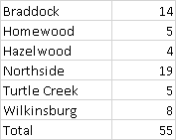
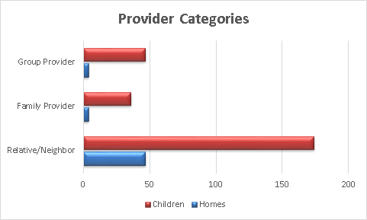
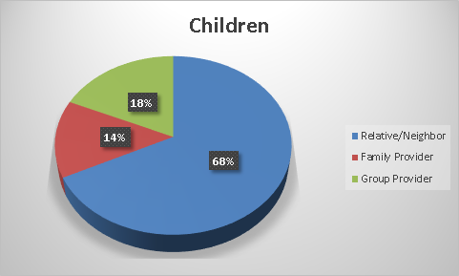
Key Underserved Neighborhoods
A total of 55 Providers

Slide 15
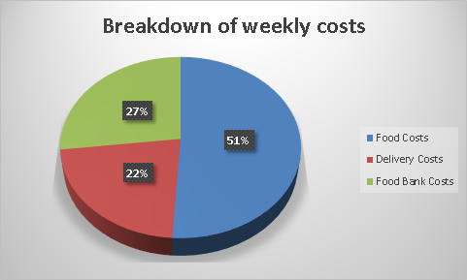
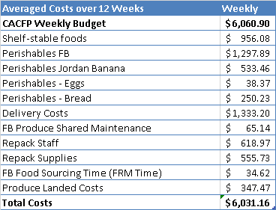
Weekly Budget vs Costs
Daily CACFP Allowance:
Maximum of $4.54 per child per day
2 Meals and 1 Snack

Slide 17
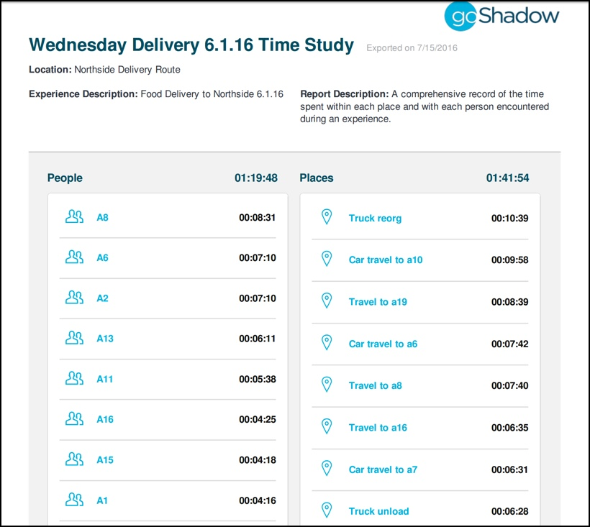
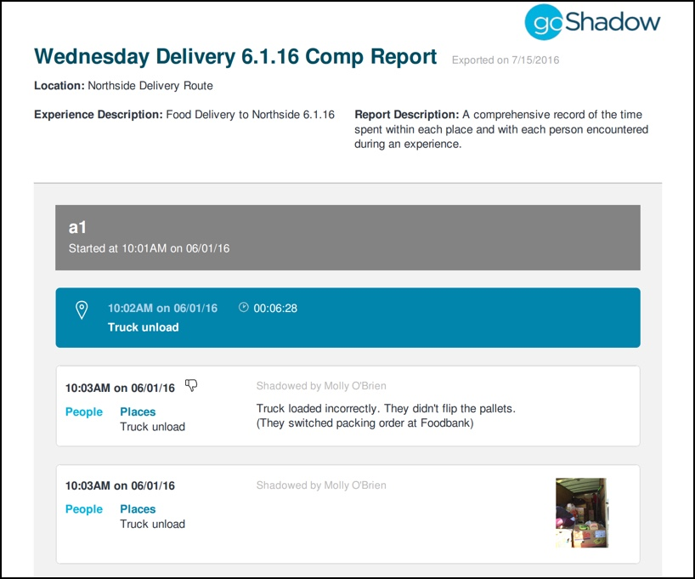
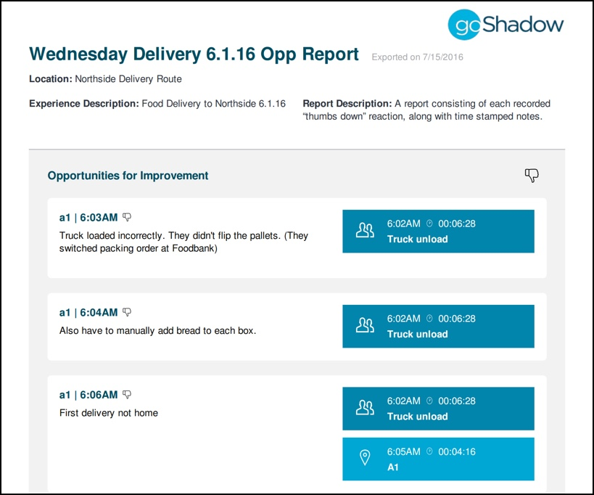
Comprehensive Reports
GoShadow offers a variety of comprehensive reports, including time studies, accolade and opportunity reports and experience flow maps.
Generated with one touch, the GoShadow reports aggregate and display shadowing data. The reports allow for ease in understanding a process, identifying areas for improvement and the alignment of goals.

Slide 18
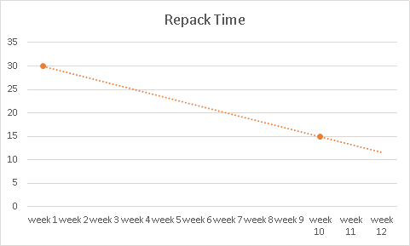
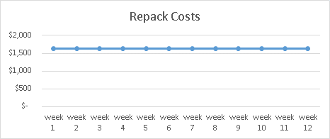
Repack Process
Week 10 Repack:
2 children per minute
11-12lbs per child
Clean/Set Up 40 mins (week 10)
Potential Capacity:
360 Children every 3 hours

Slide 19
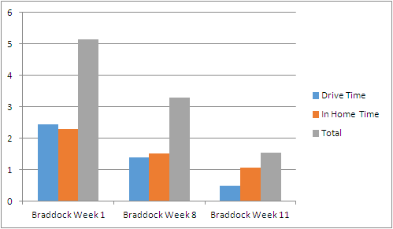
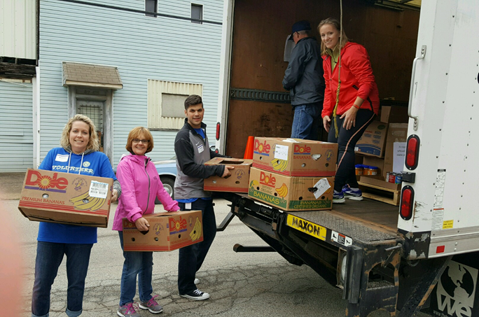
Delivery Process
Braddock Total Drive Time Week 1: 5h15
Braddock Total Drive Time Week 11: 1h55
Key Factors:
Provider Home
Provider Ready/Waiting
Driver Efficiency

Slide 20
Program Satisfaction
92% were satisfied with the quality of food each week
95% liked the weekly menus and 87% used the menus provided each week
100% reported that the program has been helpful
Braddock provider: "Program helped because I didn’t have to stretch my food stamps to purchase food for the kids.”

Slide 21
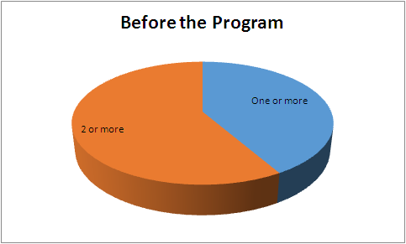
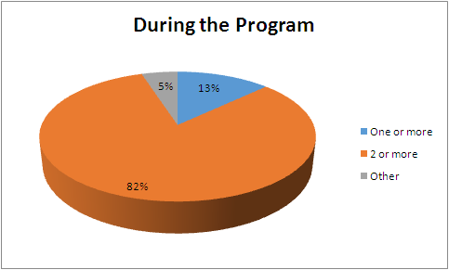
Health and Nutrition Daily Servings of Fruits & Vegetables Increased
58%
82%
Servings of 2 or more fruits & vegetables increased from 58.4% to 82%
89% reported that the program introduced children to new foods
Hazelwood provider: “The program allows them to eat more fresh fruits and vegetables because usually those foods are to expensive to buy.”

Slide 22
CACFP Reimbursement
Only 5 providers were currently on CACFP
91% were interested in signing up for CACFP
One provider who was previously enrolled in CACFP said: “I used to be part of the program, and I know I wouldn’t have been able to buy the amount and types of food you gave us on that program.”
Other reasons providers would prefer deliveries:
“I don’t have the funds to buy groceries and get reimbursed later.”
“I would prefer deliveries because then I know the money is going for food.”

Slide 23
Provider Highlight – Nicole Glaze
Group provider in Braddock
Cares for 12 children
Was spending $500/month on groceries
Did not shop while enrolled in the program
Served fruit once per day before, and served it 2-4 times/day during program
“The program was everything to me and everyone should be a part of it. It helped me get my center running, provide healthy food for the kids, and direct my energy toward other aspects of the childcare. The program gave me the ability to feed kids before school and fill babies stomachs who would come hungry.”
The deliveries have helped her sustain her childcare facility and kids are always excited when deliveries come!

Slide 24
Additional Provider Feedback
Braddock provider: “The meals have gotten healthier during the deliveries because the food delivered had fresh fruit and vegetables, where before I only bought canned.”
Braddock provider: “Through the program I learned how to cook healthier and my grandkids were eating things I never thought they would. The Program has totally transformed the way I cook and is much healthier.”

Slide 25
Additional Provider Feedback
Northside provider: Didn't have to spend money on food and could put money towards activities like science center, ice cream, resources could be used differently in general. Less pressure on her to come up with food ideas and allowed her to teach kids about healthy food and trying new things.
Northside provider: Given her the opportunity to provide additional food and more importantly healthy, nutritious food. Program has been educational and teaches how to eat healthier and give healthier food to kids.

Slide 26
Additional Provider Feedback
Braddock Provider: “The meals I served definitely got healthier. Gave me the chance to get a lot of things since when I do my own shopping I would run out of food between trips and this program prevented that.”
Turtle Creek Provider: the groceries were a huge help, she usually uses her own money to buy the food for her grandchildren whom she looks after so that her daughters “reach their dreams”. She told us it was “so special” that we could be there to help her and her family.

Slide 27
Conclusions/Next Steps
Demonstrated potential to scale and sustain within CACFP budget
Challenges: Repack is a complicated and sometimes time-consuming process
Unintended Benefits/Consequences
Tracy has a 29 year old autistic son Tyrell that who lives with her in her North Side home. He used to let us in every week. We learned that Tyrell used to be involved with an employment/mentoring program through the Carnegie Library, but stopped going because he was being picked on by neighbourhood kids at the bus stop. fitUnited was able to link Tracy with the Office of Vocational Rehab to get Tyrell back into a working program
A Provider ran into issues with landlord and was in and out of court due to rent payment disputes. She confided in us, we connected her with resources and agencies to start looking for affordable housing – she told us she was extremely lucky to have us as support because she didn’t know where else to turn for help
Next Steps:
Creating a plan to stay engaged with providers
USDA Approval

