Slide 1
Trust-Based Philanthropy Summer Learning Series June 8, 2021 10-11:30am PT

Slide 2
TBP Summer Learning Series

Slide 3
TBP Summer Learning Series
Part 1: The Purpose, Culture, and Values of Trust-Based Philanthropy | Tues. June 8 10:00-11:30am PT
Part 2: Exploring the Principles: Unrestricted Funding, Doing the Homework, Streamlined Paperwork | Tues. July 23 10:00-11:30am PT
Part 3: Exploring the Principles: Transparent Communication, Soliciting Feedback, Support Beyond the Check | Tues. Sept. 14 10:00-11:30am PT

Slide 4
Today’s Agenda (PDT)
10:05am Introduction to TBP
10:10am Putting TBP Values Into Practice
10:25am The Current Moment: Why Is TBP Trending?
10:40am The Ongoing Work of Building Trust
10:55am The Case for TBP
11:00am Transition to PSO Breakouts
11:30am Adjourn

Slide 5
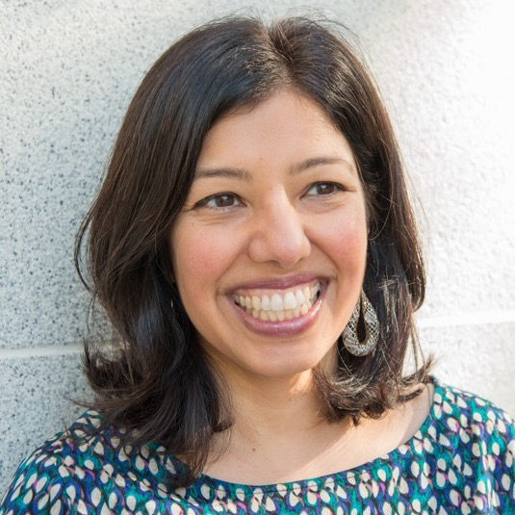
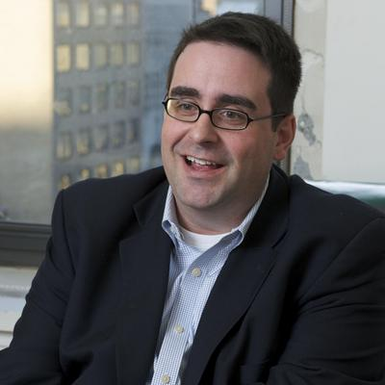
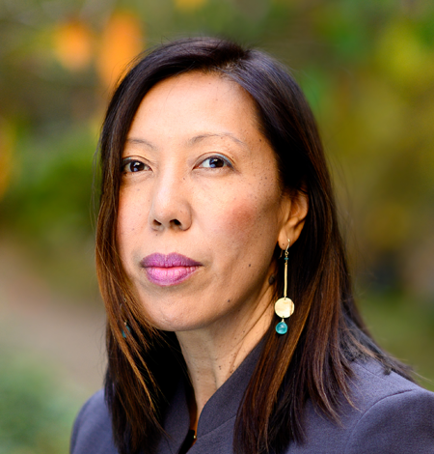
Today’s Speakers
Dimple Abichandani
Executive Director
General Service Foundation
John Brothers
President
T. Rowe Price Foundation
Pia Infante
Co-Executive Director
The Whitman Institute

Slide 6
Trust-Based Philanthropy
An approach to giving that addresses the inherent power imbalances that exist between funders, nonprofits, and the communities they serve. At its core, trust-based philanthropy is about redistributing power -- systemically, organizationally, and interpersonally -- in service of a healthier and more equitable nonprofit ecosystem. On a practical level, this includes multi-year unrestricted giving, streamlined applications and reporting, and a commitment to building relationships based on transparency, dialogue, and mutual learning.
www.trustbasedphilanthropy.org

Slide 7
The Problem:
A Values to Practice Gap in Philanthropy

Slide 8
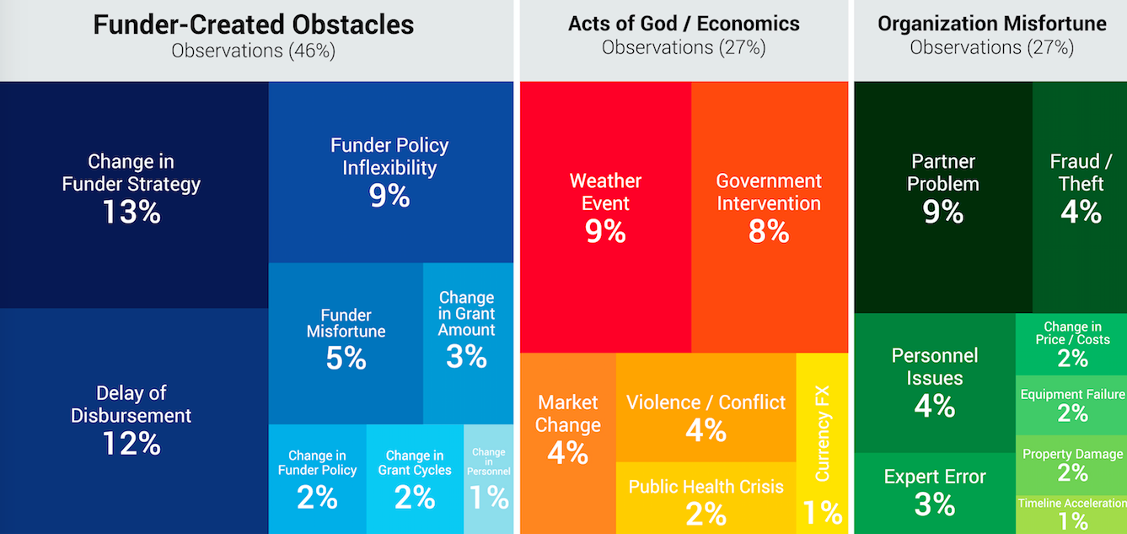
Funder-Created Obstacles: #1 Barrier to Nonprofit Impact

Slide 9
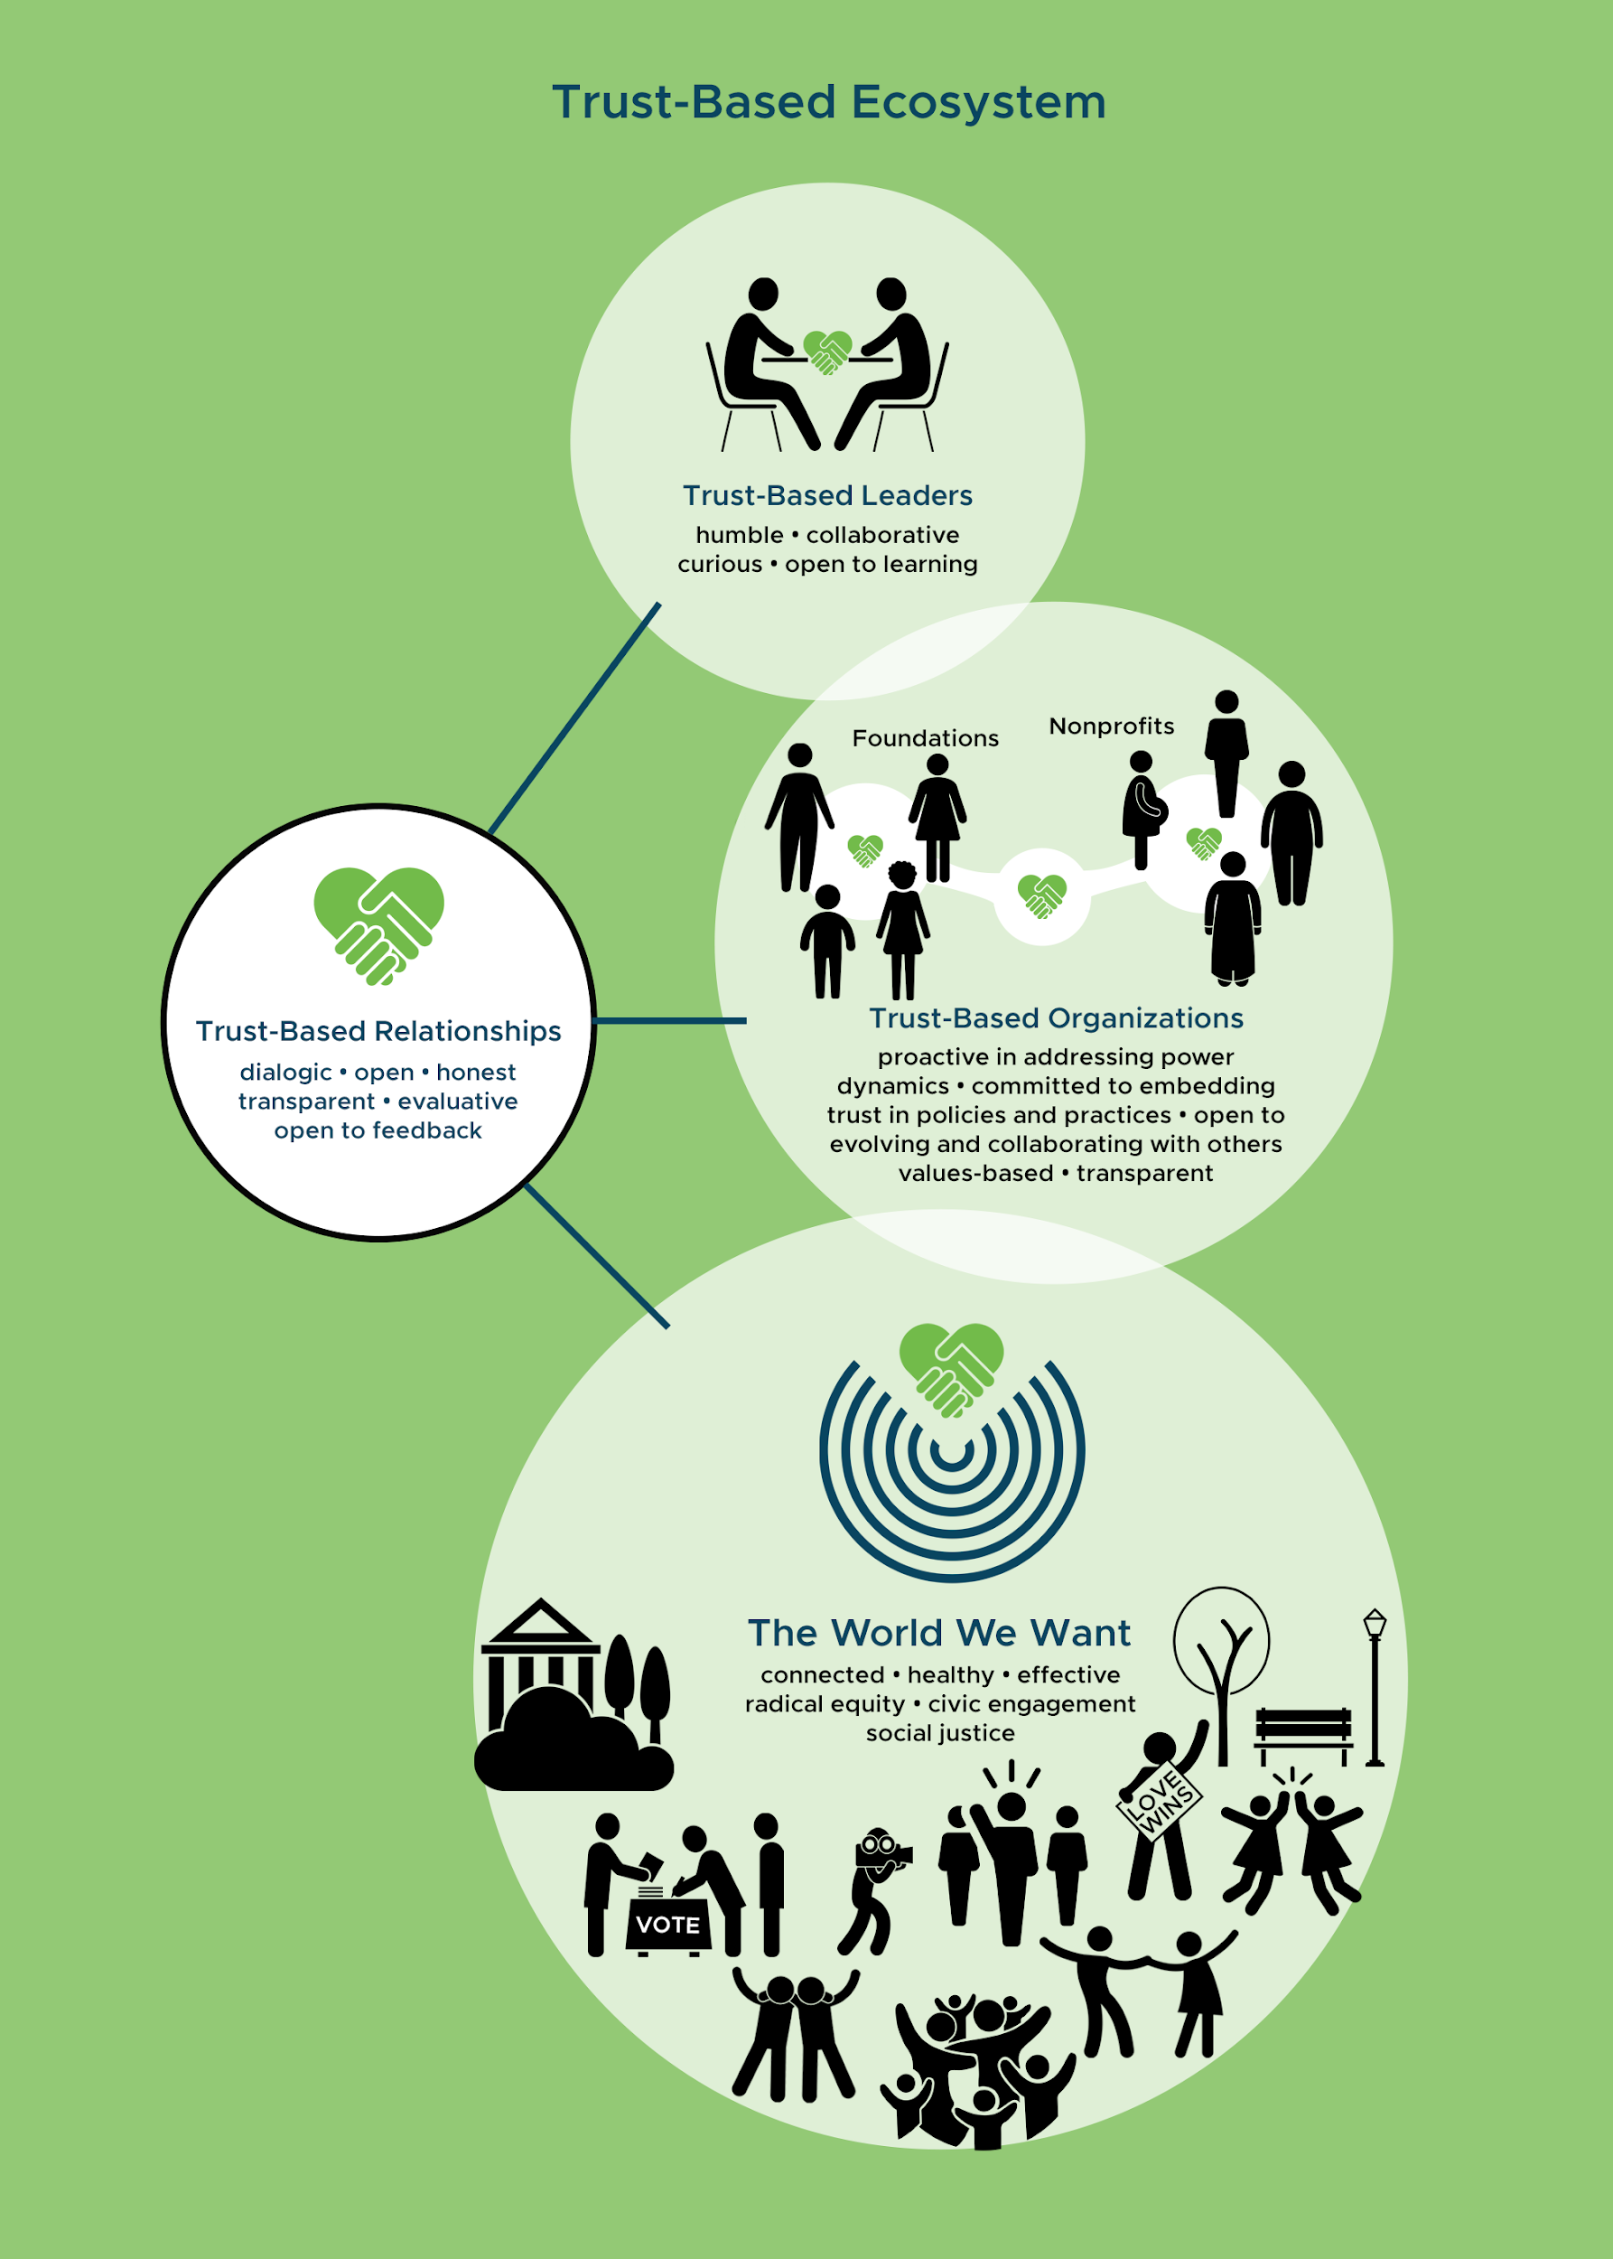
A Values-Based Approach
Acknowledge power dynamics
Trust grantees and communities
Embrace a learning mindset
Commit to systemic equity

Slide 10
6 Principles of Trust-Based Philanthropy
1
Give Multi-Year Unrestricted Funding
Do the Homework
Simplify & Streamline Paperwork
Be Transparent & Responsive
Solicit & Act on Feedback
Offer Support Beyond the Check
2
3
4
5
6
www.trustbasedphilanthropy.org

Slide 11
TBP isn’t new
It’s a journey, not a checklist
Values are the common denominator
TBP isn’t new
This is a journey, not a checklist
Values are the common denominator

Slide 12
TBP isn’t new
It’s a journey, not a checklist
Values are the common denominator
LISTEN FOR TBP VALUES
Self-awareness/power awareness ❤️
Trusting grantees & communities 👏
Learning mindset 🎉

Slide 13
Breakout Discussions
If you’re a member of a participating PSO → you will be automatically assigned to a room
If you’re not affiliated and want to engage in a discussion → stay in the main room
If you’re a PSO member and are NOT automatically assigned → tell us and we’ll help you get there!

