Slide 1
A Journey to Building Healthy Neighborhoods in Pittsburgh
GWP Community Development Network
Presley L. Gillespie, President
Doni Crawford, Program Manager for Research, Evaluation and Policy
June 19th, 2018
Proud local Southwestern Pennsylvania affiliate of

Slide 2
Meet Your Allies
Presley L. Gillespie, President
Stephanie Chernay, Chief Operating Officer
Sarah Dieleman Perry, Director of Economic Opportunity
Talia Piazza, Senior Program Manager for Communications and Marketing
Shad Henderson, Director of Community Partnerships and Investments
Zak Thomas, Senior Program Officer, Community Development Lending
Doni Crawford, Program Manager for Research, Evaluation and Policy
Shikha Jerath, Program Manager, Neighborhood Engagement and Community Capacity Building
Cait Lee, Program Manager, Community Trauma
Ben Emswiler, PULSE Fellow

Slide 3
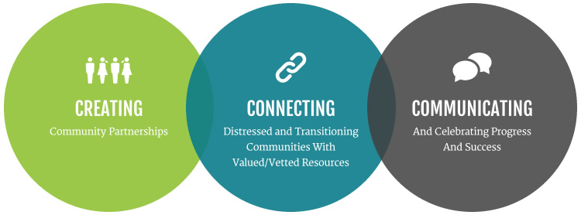
Our mission is to support the people, organizations and partnerships committed to creating and maintaining healthy neighborhoods.
We do this by:

Slide 4
Neighborhood Level Strategies & Our Role
Our role as a community partner at
the neighborhood level is to:
• Act as convener to support the collective neighborhood vision and strategy
• Support and connect aligned activities and expand broader partnerships
• Establish shared measurements
• Build public will and social capital
• Introduce best practices and serve as thought leaders on policy coordination
• Seek, develop, and mobilize Complete Capital for high-impact neighborhood projects

Slide 5
MARKET CONFIDENCE | Mobilize private and public non-displacement strategies and restore real estate market
values so people can invest confidently
Healthy Neighborhoods Framework
QUALITY OF LIFE | Increase financial stability of residents, facilitate access to mental, behavioral, and social support services, and improve the physical conditions of the neighborhood to advance overall health and well being.
NEIGHBORHOOD IMAGE | Cultivate hope among all residents for neighborhood change through community-driven arts and culture, improved public spaces, and the preservation of history, culture and identity.
COMMUNITY OWNERSHIP | Strengthen neighborhood platforms that elevate and perpetuate residents as decision-makers and active participants in neighborhood change, and leverage assets to generate revenue that can be
reinvestment into future activities and improvement

Slide 6
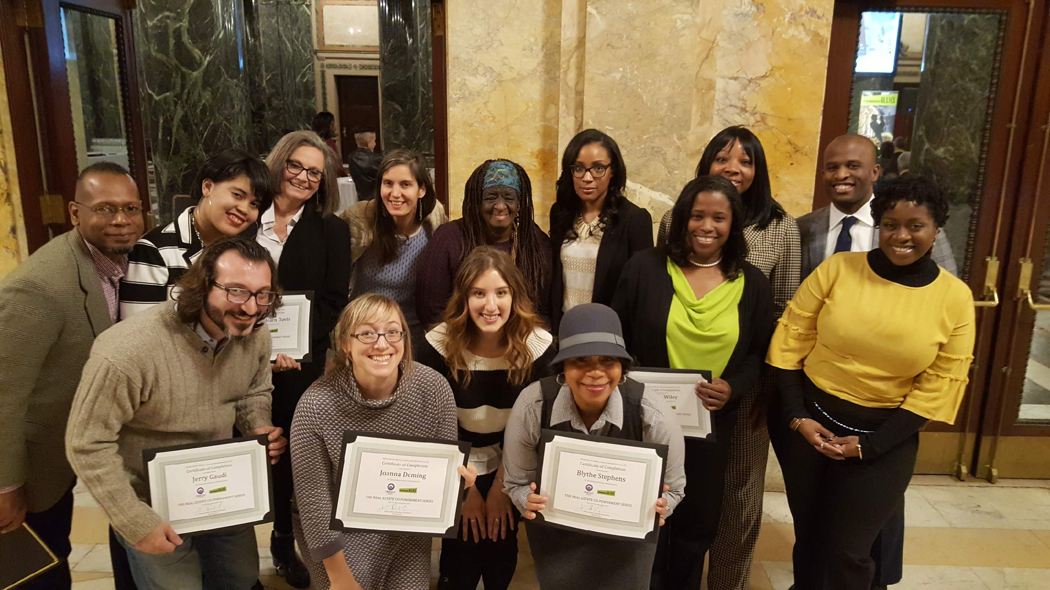
Notes:
Our third cohort of the Real Estate Co-Powerment kicked off in April and welcomed one of our most diverse cohorts yet! Since launching in early 2017, we have graduated 23 students from the Co-Powerment Series. Our cohort participants have been targeted and diverse from the start, with representation from multiple backgrounds and sectors ranging from community residents and CDC/CBO staff members to non-profit board members and small business owners–each have varying levels of exposure to the real estate discipline. In April 2017 we’re happy to share that we’ve welcomed 14 more diverse participants to the Co-Powerment Family

Slide 7
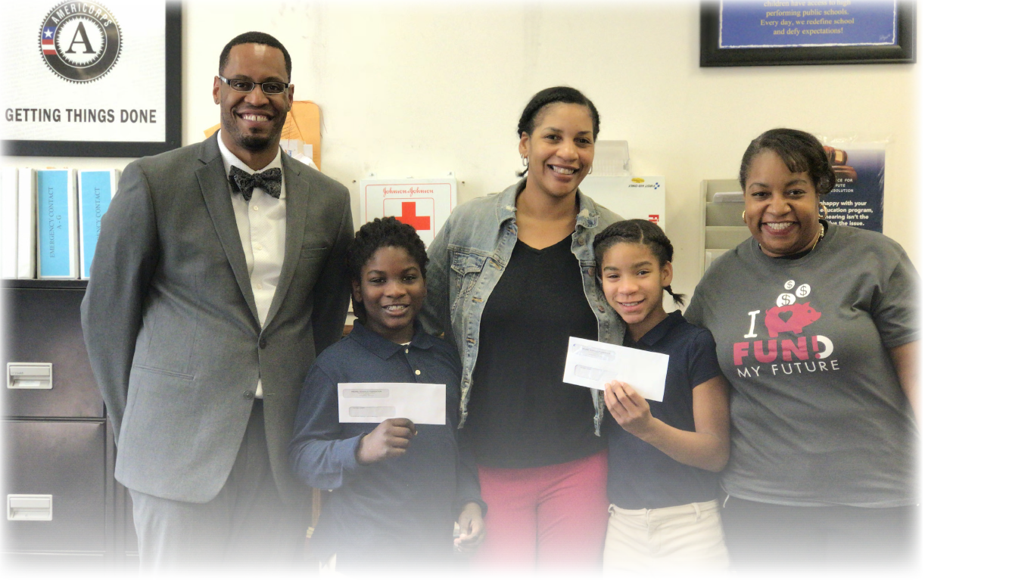

Slide 8
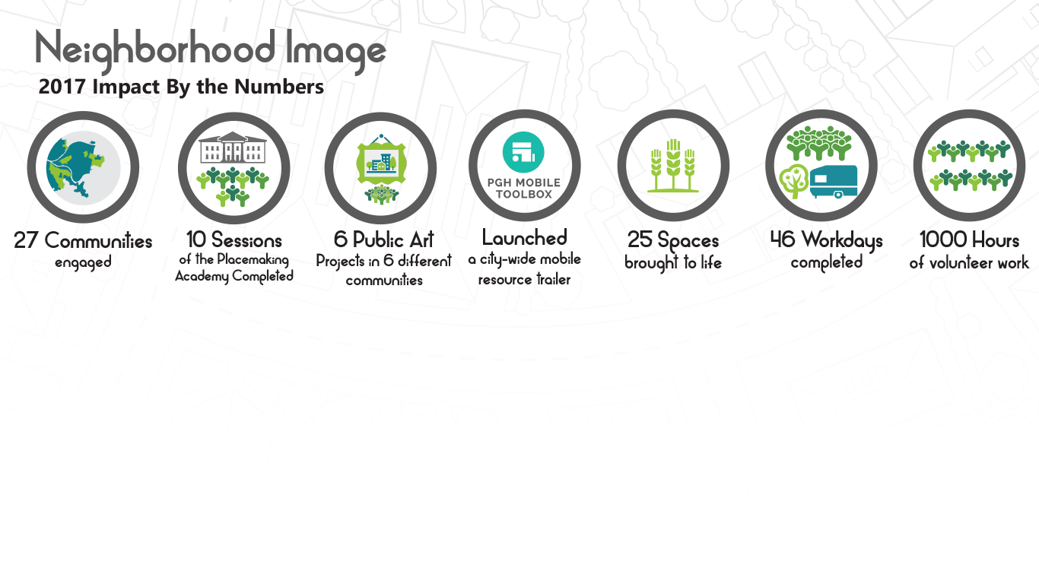
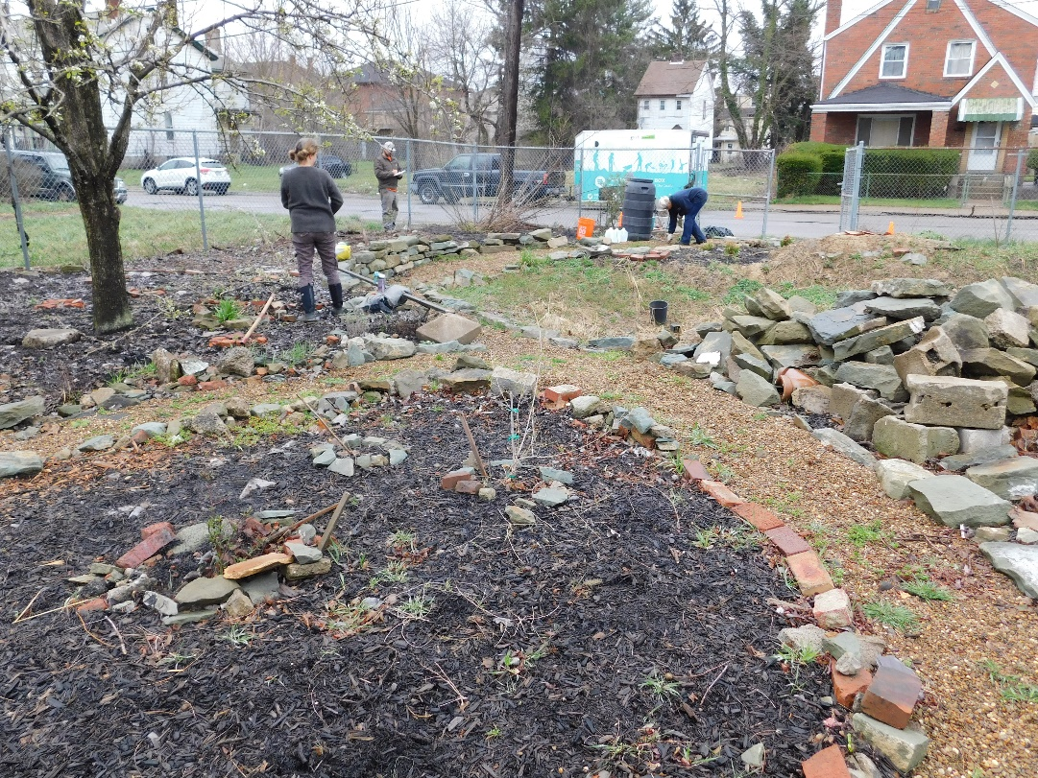

Slide 9
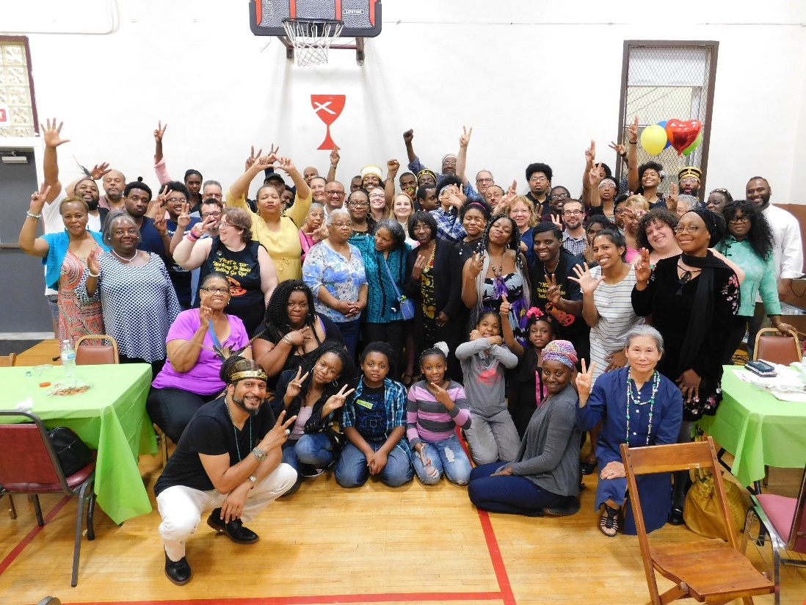
Notes:
With double the amount of applicants and creative project ideas than last year, Our Love My Neighbor! grant program is reaching and supporting more of Pittsburgh’s residents than ever! As a result of the increased efforts by the residents in our communities, Neighborhood Allies has increased the grant pool from $63,000 to $100,000 for the third round of Love My Neighbor!

Slide 10
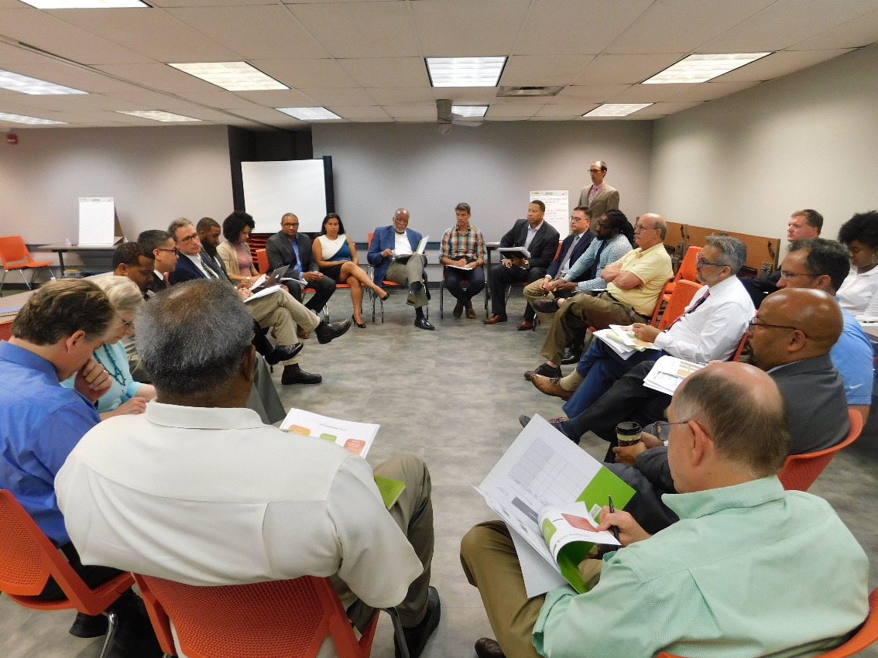

Slide 11
We are extremely grateful to our dedicated funders; without their support this work is truly not possible. Together, we will propel our neighborhoods and our residents to a better tomorrow.
Core Funders:
Anonymous Donor
The Heinz Endowments
The Pittsburgh Foundation
Program Funders:
Bank of America
Bank of New York Mellon
BNY Mellon Foundation of Southwestern Pennsylvania
The Birmingham Foundation
The Buhl Foundation
City of Pittsburgh, Community Development Block Grant
Dollar Bank
First Commonwealth Bank
First National Bank of PA
Grable Foundation
Hillman Family Foundation
Huntington Bank
KeyBank
KeyBank Foundation
Local Initiatives Support Corporation (LISC)
McAuley Ministries
National Equity Fund (NEF)
National League of Cities
PNC Foundation
PNC Charitable Trusts
Roy A. Hunt Foundation
ReedSmith, LLP
Staunton Farm Foundation
Urban Redevelopment Authority

Slide 12
Thank You!

