Slide 1
Nonprofit Capitalization
Taking the Plunge Together
March 26, 2015
University of Pittsburgh
Co-Presented by The Philanthropy Forum at GSPIA
Grantmakers of Western PA

Slide 2
Key Facts
Capital Aggregation at the Edna McConnell
Clark Foundation (EMCF):
Since 2007: $155 million in growth capital from EMCF
$454 million in coordinated co-investment from 46 partners and the federal Social Innovation Fund; average co-investment $6 million

Slide 3
Campaigns for Individual Organizations
Growth Capital Aggregation Pilot (GCAP) – 2007
Nurse-Family Partnership -- $50 million, 5 years,
extended to 7 years
$12 million EMCF
$38 million from 7 co-investors and NFP board
Citizen Schools -- $48.8 million in two raises, 8 years
$18 million EMCF
$30.8 million from 14 co-investors and CS board
Youth Villages -- $85 million in 2 raises, 10 years
$30 million EMCF
$55 million from 15 co-investors and HCZ board

Slide 4
Campaigns for Individual Organizations
Harlem Children’s Zone – 2010, $80 million, 4 years
$15 million EMCF
$65 million from 8 co-investors and HCZ board

Slide 5
True North Fund -- 2011
12 Grantees – selected in mandated open competition
Grants (including match) ranged from $7 to $12 million over 3-4 years
BELL | Children’s Institute | Reading Partners
Center for Employment Opportunities | Communities in Schools | The SEED Foundation
Carrera Adolescent Pregnancy Prevention Program | Gateway to College National Network | WINGS for Kids
Children’s Home Society of North Carolina | PACE Center for Girls | Youth Guidance – Becoming a Man

Slide 6
True North Fund
$123 million
$30 million EMCF
$30 million Social Innovation Fund
$63 million from 14 co-investors
50% General Fund
25% Regional Partners
25% Individual Grantees
7 institutional co-investors
7 living donors
Operating partnership with the Bridgespan Group and MDRC
Communities in Schools -- $18.75 million, 6 years
$12 million EMCF + SIF + Match
$3 million co-investor follow-on
$3.75 million EMCF follow-on

Slide 7
EMCF Investment Approach Key Elements
Enterprise–level investments
Unrestricted, payout contingent on performance
Business planning
Relationship management and support, board participation
Performance measurement
Reporting against agreed milestones
Formal evaluation

Slide 8
The Philanthropy Forum, GSPIA March 26, 2015
Tamar Bauer – Chief Policy & Government Affairs Officer

Slide 9
Evolution of Nurse-Family Partnership
National Growth
Transition
Initial Replication
Research
1977 |  | 1996 |  | 2003 | 2007 |  |  | Today

Slide 10
Estimated Public Investment in Nurse-Family Partnership
Year* | Total Investment
2007 | $73
2008 | $86
2009 | $105
2010 | $131
2011 | $137
2012 | $147
2013 | $187
2014 | $213
Grand Total | $1,078
*12 months preceding 9/30

Slide 11
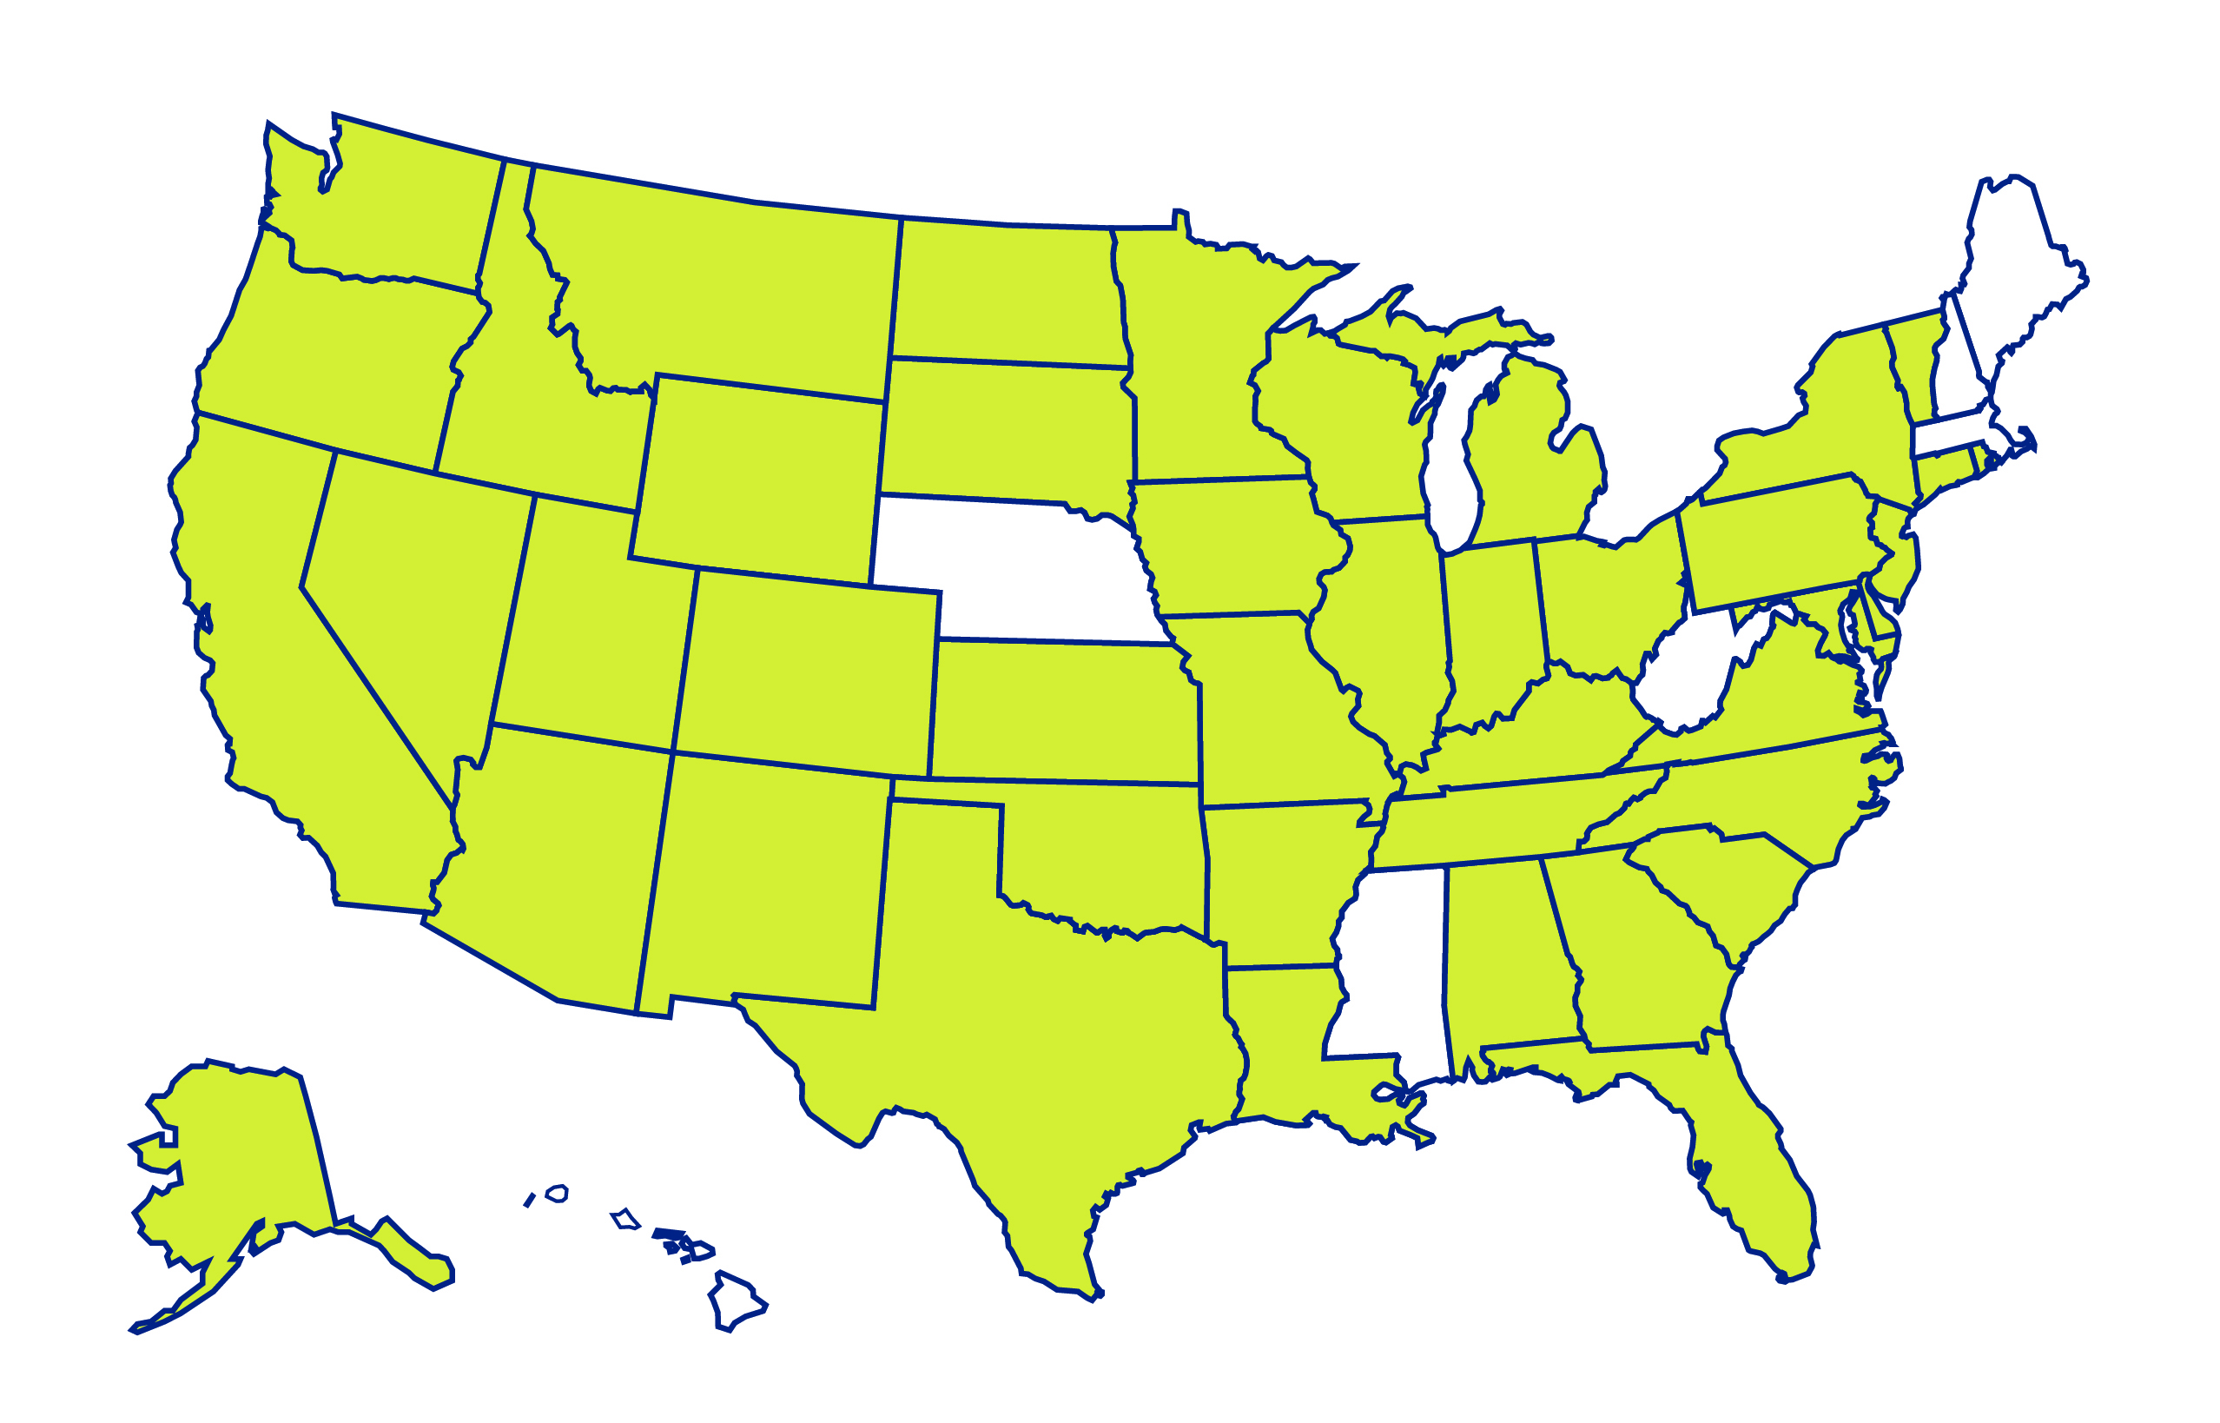
Nurse-Family Partnership National Map
Port Gamble
S’Klallam Tribe
The Pine Ridge Reservation of the
Oglala Lakota
White Earth
Band of Ojibwe
15
Fond du Lac Band of
Lake Superior Chippewa
11
4
1
10
2
38
13
5
9
14
9
3
5
43
2
1
5
2
18
1
56
1
3
21
1
17
5
1
1
1
19
3
1
77
7
25
Eastern Band
of Cherokee Indians
2
2
34
53
Nutaqsiivik Southcentral Foundation
11
1
Tribal agencies are denoted by Band
Map does not include program in
U.S. Virgin Islands

Slide 12
This We Believe…
Every child is our child.
No child is forgotten.
Relationships, not programs, change lives.
We commit to a future in which every child has the opportunity to shape his or her world, and ours, for the better.
Notes:
This is at the heart of the very word, philanthropy….it is outward facing. It’s a distinguishing characteristic of this field and the intersection between philanthropy and the nonprofit, particularly the nonprofit service field.

Slide 13
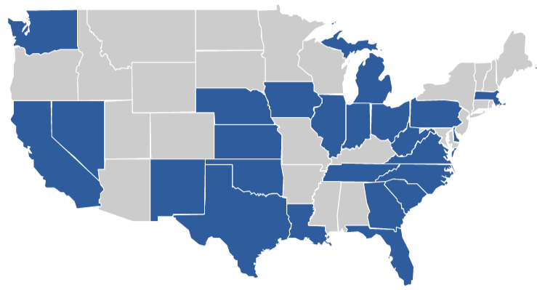
The CIS Network: 1.48 Million Students and…
K, can you add topline Network states: students, parents, schools AND the following outcomes: improved academic outcomes, lower dropout rates, improved graduation rates.
91%
of eligible seniors graduated
26 States + DC
1.48 million
students and their families were served
82%
Met academic improvement goals
99%
of targeted & monitored students remained in school
234,000
parents, families
and guardian partners
2,400
schools/ community sites
Notes:
Communities In Schools targets the most at-risk students in our nation’s most poverty stricken schools in some of our most challenging communities.
And we are making a difference [CLICK]

Slide 14
The CIS Network:
26 States + DC
91%
of eligible seniors graduated
1.48 million
82%
met academic goals
234,000
students/families
2,400
schools/sites
99%
of targeted & monitored students remained in school
Notes:
Communities In Schools targets the most at-risk students in our nation’s most poverty stricken schools in some of our most challenging communities.
And we are making a difference [CLICK]

Slide 15
Our Journey
Innovation = Impact
Innovative Leaders
Iterating

Slide 16
Our Journey
Growth = Impact
Drive to reach as many young people in need

Slide 17
Our Journey
Doom Loop
Crisis

Slide 18
Our Journey
Growth + Quality = Impact
Building Organizational Quality
Growth Capital Campaign

Slide 19
Quality Improvement Fueled by Capital Aggregation
2007
217 state/local orgs
1.24 million students
2015
165 state/local Orgs
1.5 million students
2007
$199 m
Network Revenues
2015
$199 m
Network Revenues
CIS Raise/Expended $2.4 b
CIS Served 9.3 m Students Cumulatively
Consistently Strong Outcomes
Notes:
To date, 114 affiliates and 7 state offices have been accredited, serving over 1.1 million students. Over the last seven years, our heightened focus on implementation of the evidence based CIS model and strong CIS business operations has yield significant results.

Slide 20
Building Evidence to Improve Policy and Practice
John Martinez
Deputy Director of Program Development

Slide 21
What is MDRC?
Nonpartisan, nonprofit, independent
Education and social policy
Develops and evaluates solutions to problems
40 years of experience

Slide 22
What data should organizations collect?
WHO is being served (and not served?)?
WHAT services are being delivered?
HOW MUCH service is being received (dosage/intensity)?
HOW are those being served doing (outcomes)?
Having a LOGIC MODEL or THEORY OF CHANGE is extremely helpful!

Slide 23
What questions can internal data answer?
Is the organization serving who they think they are?
Is the program/intervention being delivered as planned?
Do recipients of services appear to be benefitting?
Key tool for performance management

Slide 24
Role of third party (rigorous) evaluation
Objective assessment
Opportunities to further strengthen/improve
Can answer the question: what difference does a program make
Should be an important tool in performance measurement/program improvement
Provides valuable information for scaling

Slide 25
Some “DOs” and DON’Ts” to 3rd party evals
Shouldn’t simply provide a “thumbs up” or “thumbs down”
Important to ID what worked, what didn’t, why, and if possible, how to improve
Shouldn’t be a “one and done”
Important to continue to build evidence
Evaluator shouldn’t be solely “driving the bus”
Eval should also answer organization’s ques

Slide 26
Communication: I have results, now what?
Research reports
Reframe and repackage results to speak to a wide range of stakeholders (“Translate”)
Actively disseminate results so it gets into the hands of policy makers

Slide 28
John.Martinez@mdrc.org
WWW.MDRC.ORG

