Slide 1
Impact Investing Panel
Ford Foundation
Kresge Foundation
The Philanthropy Forum at GSPIA
Grantmakers of Western Pennsylvania
January 28, 2015

Slide 2

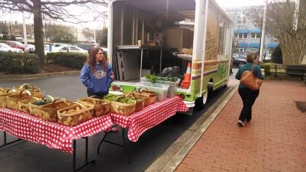

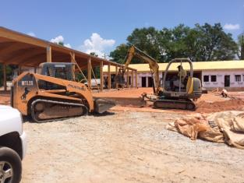
South Carolina Community Loan Fund
Notes:
$500K loan and $450K grant, including $200K to fund a LLR.
Leveraged $1.5MM in other investments from both philanthropic and private sector.
Support to extend SCCLF’s healthy food lending beyond the POS (grocery stores) and into more upstream parts of the food system including food hubs, farmer’s market, and more local production and processing. Goal is greater access to fresh, local produce (health benefits) and the strengthening of the local food systems in South Carolina (food security).

Slide 3
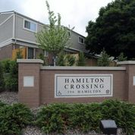





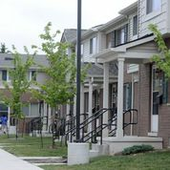
Hamilton Crossing – The Strong Families Fund
Notes:
History: grants by our Human Services team to SAHF (to develop a common set of metrics related to resident outcomes) and Hamilton Crossing (LIHTC family project in Ypsilanti using a data-driven approach to collect resident outcomes with Eastern MI Univ). In most cases, resident services are paid for by grants or excess cash flow at the project level – both unpredictable and varying over time. SFF is using a P4P mechanics that may provide developers a ten year source for social service coordination when there is evidence that resident outcomes are improving. The fund is a partnership with Great Lakes Capital ($1.5MM guarantee), National Affordable Housing Trust ($2.0MM guarantee), Community Development Trust ($3.0MM loan), and CSH ($1.25MM grant).
Kresge’s $7.75MM investment (grants, guarantees and debt) will leverage $74.8MM from other sources including $4.8MM in grants from the Robert Wood Johnson Foundation and $70MM in private sector investments of debt and equity.
The Fund is expected to finance 6-8 projects generating approximately 600-700 new units of service supported housing.
To generate a funding source that will enable developers to consistently provide high-quality, service coordination, the effort will utilize one or more of the following levers:
-- the release of operating and/or Section 8 transition reserves (and replacement with the Kresge guarantee) to pay for service coordinators in years 1-2;
-- first mortgage debt with a grant funded “rebate” tied to outcome measurements, which can provide a method for funding service coordinators in years 3 through 10 and;
-- an additional equity payment from the LIHTC investor to the developer in year 10 if outcomes are achieved

Slide 4
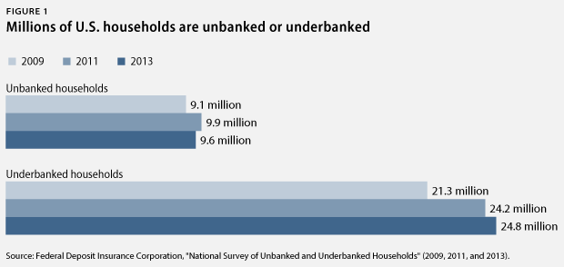
Core Innovation Capital - VC
Notes:
Approximately 35 mm US households are underserved by the financial system – lack access to bank accounts altogether (unbanked) or rely on alternative providers, such as check cashers, payday lenders or pawn shops (underbanked) for their financial services
Core – first private equity fund exclusively focused on investing in companies that would provide financial products and services to the un/underbanked
Ford’s investment $3 mm / LP interest
Portfolio companies include:
An online marketplace for auto and homeowners insurance
Mobile wallet
Unsecured small $ credit
Online debt management services
Alternative payment and asset date to create predictive credit models

Slide 5
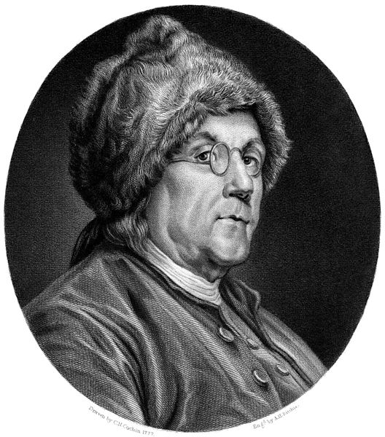
Notes:
Benjamin Franklin often cited as the first impact investor! In his will, Franklin left the bulk of his wealth to create revolving loan funds so that aspiring young tradesmen and shopkeepers could borrow a little money to get started, then pay it back so that subsequent young entrepreneurs could get a helping hand. These loan funds worked for more than two centuries.

Slide 6

What is impact investing?
Impact investments include any type of investment that is intended and designed to generate both a measurable social or environmental benefit and a financial return.
Program-related investments (PRIs)
Other investments for social or environmental mission
Sometimes called
    Mission-driven
    Mission-related (MRIs)
    Impact

Slide 7
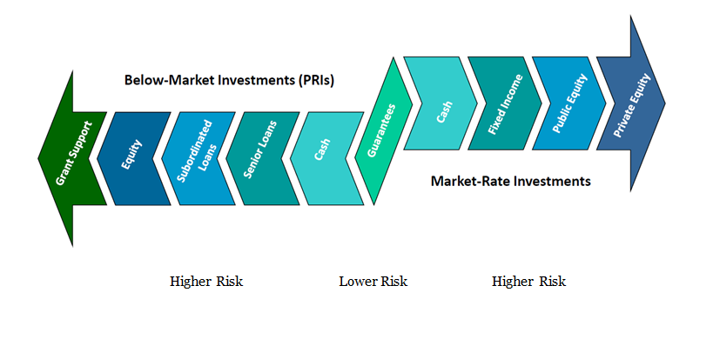
Impact Investment Continuum
Source: The F.B. Heron Foundation

Slide 8
Foundation Investments
Mission or Social Investments
Endowment Investments
Grants
Programmatic Returns
Financial Returns

Slide 9
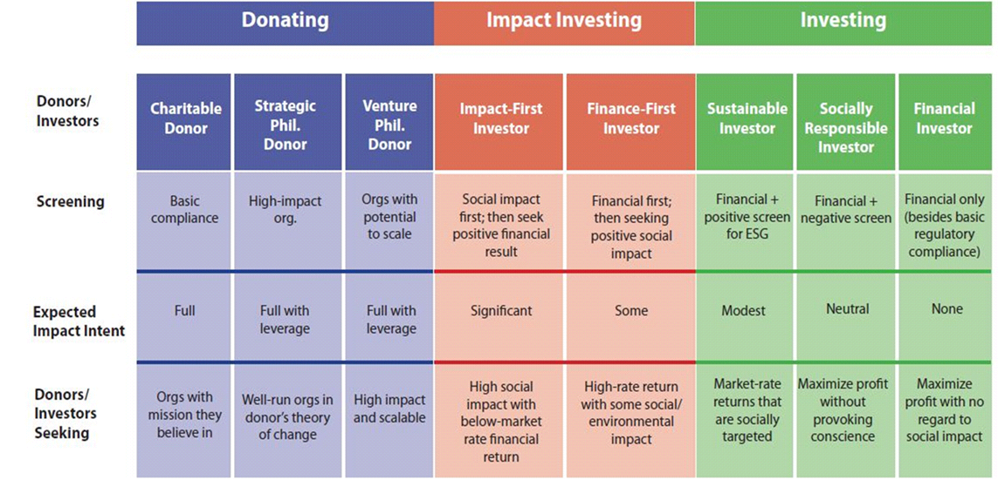
Social + Financial (or Environmental) Gain =
Investing for Impact
Source: Calvert Foundation
Notes:
The crevasse between social and financial gain is mission investing or investing for impact.

Slide 10
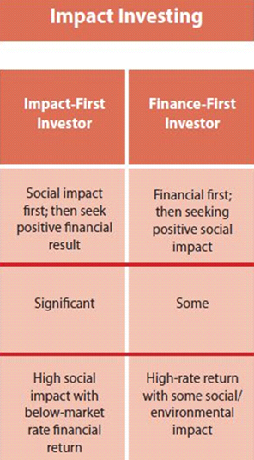
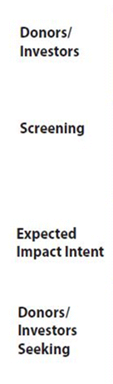
Impact Investing
PRI
MRI
Notes:
For an investor more geared towards social impact, on the left, they expect significant return, with some return on investment being second. That would be below-market rates of financial return. For private foundations and in terminology also used by community foundations, these are called program related investments or PRIs. Impact first – financial results second. But returns can still come in with a PRI without loss to the foundation’s tax status for that investment.
For Finance First impact investors, they, like any prudent investor, seek financial gain first – maintaining the integrity of the foundation’s corpus; while at the same time seeking positive social impact. They are looking for high rates of return with the added bonus of positive social and environmental impact. These are called mission-related investments, or mission-driven investments. They are expected to return financially at the market rate.
Program-related investments, or PRIs, on the left side, are called concessionary term investments – concessionary meaning that the investor is giving something up. A prudent investor for financial gain would not enter into a PRI – it is mission first, with returns being OK at whatever rate is established in the case of debt; or whatever rate is returned (including zero or zillions) on the equity (or stock purchase) side.

Slide 11
Traditional Philanthropy
Fund
Grants from Earnings
~ 5% of assets
Invest
Endowment Assets
95% of assets
Seek only financial return to fund grants while preserving or growing endowment
Seek only social return
by making grants
Notes:
11
Much of the current impetus for PRI comes from asking how foundations can more fully deploy all of their resources to accelerate social change.

Slide 12
New Philanthropic Investing Continuum
PRIs: Program- Related Investments
MRIs: Mission- Related Investments
Recoverable Grants
Endowment Investments
Grants
Primary Motivation:
Social Return
Primary Motivation:
Financial Return
.
Notes:
12

Slide 13
What is a Program Related Investment (PRI)?
A PRI is an investment that possesses all of the following characteristics
Its primary purpose is to accomplish a charitable, educational, or other similar purpose
The production of income or capital appreciation is not a significant purpose of the investment
It is not made to influence legislation or campaign on behalf of a candidate for public office
Notes:
To qualify as a PRI, an investment must meet a three-part test.

Slide 14
Program-Related Investments
Like grants, they make foundation funds available for charitable purposes
but
Unlike grants, they are expected to be repaid, often with at least a modest financial return
and
Unlike other foundation investments, they cannot be made for the primary purpose of financial gain.

Slide 15
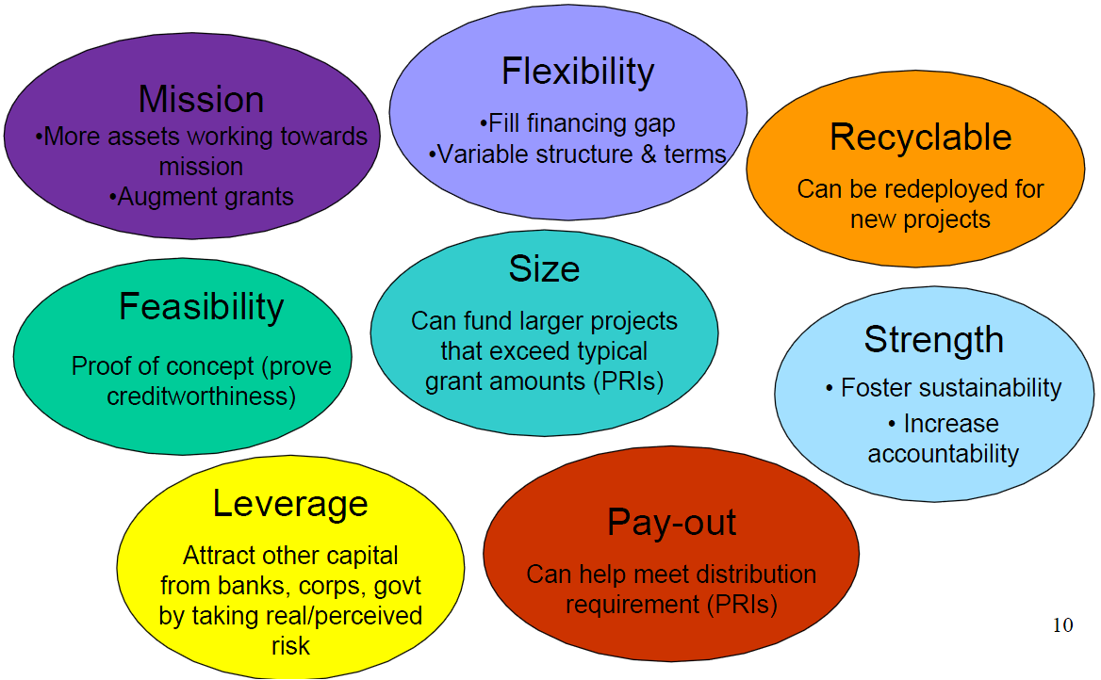
PRI Benefits for Foundations

Slide 16
Benefits to Recipients
Access to inexpensive investment capital
Strengthens financial capacity
Builds credit and performance record
16

Slide 17
Ripe for PRIs?
Reliable Income Stream
Feasible Business Plan
Financial and Managerial Capacity

Slide 18
PRIs – The Challenges
Can be complex and time consuming
Requires programmatic and financial skills
Legal fees and other transaction costs
Negotiations and structuring potentially adversarial
Social impact difficult to measure / quantify
Long-term reporting and monitoring

Slide 19
Mission-Related Investments (MRIs)
Align corpus investments with mission
Increase flow of capital to underserved/high risk markets
Generate social or environmental benefits
Achieve a competitive financial return

Slide 20
The Ford Foundation’s
PRI Program

Slide 21
Ford Foundation PRI Fund - History
Ford pioneered the use of PRIs in 1968
From 1968-2014, Ford committed over $650 million in PRIs
The PRI Fund currently is capped at $280 million, with $250 million outstanding and committed

Slide 22
Ford Foundation PRI Fund –
Distribution by Geography
$250 million outstanding & committed

Slide 23
Ford Foundation PRI Fund –
Distribution by Sector
$250 million outstanding & committed

Slide 24
The Kresge Foundation’s
Social Investments Practice

Slide 25
Kresge’s Social Investment Practice
The Social Investment Practice works to advance programmatic priorities by deploying a range of tools to fill unmet capital needs.
The Practice seeks to create and/or invest in transactions that align with the Foundation’s strategies, leverage resources from other investors and achieve high social impact.
Notes:
Started in 2009 with Community Relief Fund; short-term working capital loans to human services organizations to weather the 2008 financial downturn

Slide 26
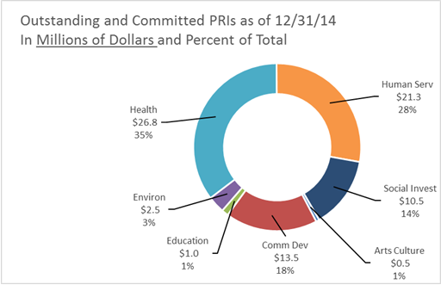
Total Social Investments by Program

Slide 27
Roadmap to Integration
Early experimentation
Intentional Learning
Integrated Capital Deployment
What do we do?
How do we do it?
Disconnected from Program
Expanded set of tools
Engage a broad group in determining the “future state”
Establish indicators of success for impact, integration, risk
Intentionally link grants to the requirements for future investment
Use grants to seed investments
Advance Program priorities with other forms of capital
Build organizational infrastructure
Evolve external understanding of the resources the Foundation has available
Evolve strategies to reflect capital barriers

Slide 28
Kresge Screening for Financeable Opportunities
What is the proximity of this investment opportunity to program strategy? Is Program onboard with this opportunity?
Is non-grant capital needed to fulfill the scale of the problem/need?
Is the ratio of impact to risk right? i.e. high risk transactions = high potential for impact
Is there a potential source of repayment (cash flow, earned revenue, etc.)?
Does organization have a strong financial track record, or evidence of future strong financial performance?
Does organization have evidence of their ability to take on and manage debt?
Does the organization have clear and measureable objectives for how the money would be used and the impact It will have?
Would Kresge’s role help to attract additional capital sources? Can we be a good co-investor by participating in this transaction?

Slide 29

Social Investment Tools - Loans
An entity or individual borrows an amount of money, called the principal, from the lender, and is obligated to repay an equal amount of money to the lender at a later time. Typically, the money is paid back in regular installments, or partial repayments.
The loan is generally provided at a cost, referred to as interest on the debt. In a legal loan, each of these obligations and restrictions is enforced by contract, which can also place the borrower under additional restrictions known as loan covenants.
Kresge’s Social Investment Practice can provide debt with flexible
structures including low-interest rates, interest-only periods,
long terms, and performance-based pricing and
repayment expectations.

Slide 30

Social Investment Tools – Credit Enhancement
Credit enhancement is generally used to incentivize the issuance of debt or to obtain better terms for debt instruments. Through credit enhancement, the lender is provided with reassurance that the borrower will honor the obligation.
Typical forms of credit enhancement include additional collateral, insurance, 3rd party guarantees, subordinate debt, and loan loss reserves.
Kresge’s Social Investment Practice can provide credit enhancement in the form of subordinate debt and guarantees while Programs can use grants to fund loan loss reserves.

Slide 31

Social Investment Tools - Equity
An equity investment is an investment in a for-profit in exchange for a share in the ownership of the company. In the event of a bankruptcy, liquidation, or other inability for the company to repay its investors, equity investors will be repaid last after all other obligations including loans, taxes, and operating expenses.
Kresge’s Social Investment Practice can make equity investments in for-profit organizations in exchange for ownership shares. Kresge/SIP can also make loans to for-profit organizations that may convert to equity under certain conditions.

Slide 32

Colorado Coalition for the Homeless
Notes:
Kresge provided a $3.0MM loan to this nonprofit organization that provides housing and health services to vulnerable residents and communities in Denver. They follow a “housing first” approach and assist 15,000 individuals/families each year, including 12,000 unduplicated patients in their health care program. Altogether, they manage 1,530 supportive housing units in Denver. This loan allows the expansion of CCH’s health services component and has a pay-for-performance component the reduces CCH’s interest rate to as low as 1% based on improved client outcomes related to health and housing stability.
Kresge grant funds helped to cover additional staff hires and training and the state of CO also provided $400K in grant funding to support the effort.

Slide 33
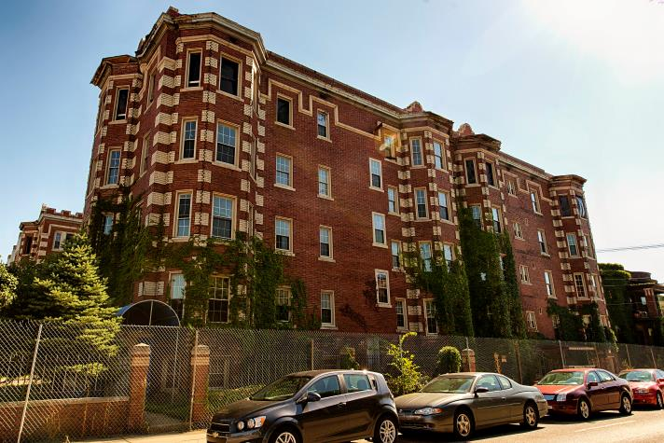
Woodward Corridor Investment Fund
Notes:
$30MM fund for market-rate + workforce housing + commercial space along Woodward Corridor in the heart of Detroit
Led by Capital Impact Partners, national CDFI and developed in collaboration with local developers
Investors included private (MetLife, Pru, PNC), philanthropic (Kresge), and non-profit (Capital Impact, Calvert Foundation) organizations
Kresge is providing $5.0MM in 15-year debt and a $1.25MM guarantee to Calvert Foundation + $500K in grants.

Slide 34
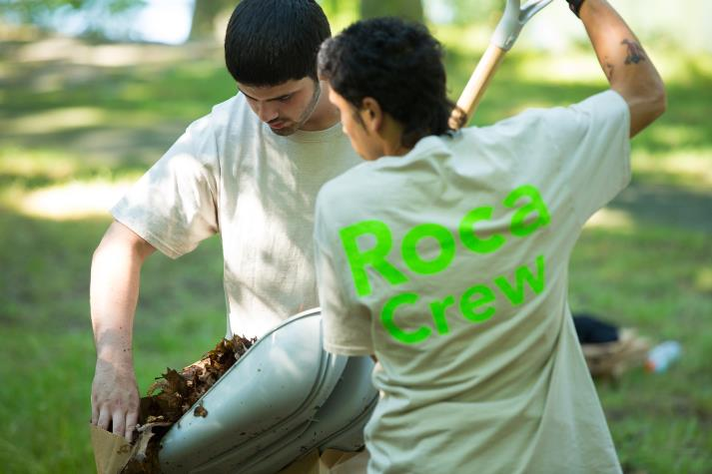
Roca, Inc.
Notes:
Roca is a long-established Boston based non-profit organization whose mission is to help disengaged and disenfranchised young people move out of violence and poverty. Roca has designed and administers a 16-quarter cognitive-behavioral intervention model that targets young men involved in the criminal justice system, enabling them to transform their lives and move them toward the outcomes of economic independence (i.e. successfully keeping a job) and living out of harm’s way (i.e. staying out of prison).
Kresge provided a $1.5MM subordinate loan as part of a $20MM++ pay-for-success transaction with Goldman Sachs as the senior lender and a number of Foundations providing both subordinate and grant capital. Loan repayment is solely dependent on Roca reducing recidivism and enhancing employment. Payment to investors will be determined by the results of the randomized control trial (RCT). Beginning in year five, the state of Massachusetts will make up to $27 million in "success payments" for avoided bed-days of incarceration, increases in employment, and achievement of job readiness among the target population.

Slide 35
Project Level Finance
Investment in a specific project (often real estate)
Funds used exclusively to solve a problem within a specific project
Enterprise Level Finance
Investment in an organization for growth, capacity building, expansion etc.
Fund not tied to a specific use: can be used for working capital, site acquisition, balance sheet equity
Sector Level Finance
Diagnosis of the barriers that prevent capital from flowing in a sector
Multiple investments designed to unlock/unstick barrier, prevents more traditional investment from taking place
Example: Paverello Center secured leverage loan for development of a new multi service center
Example: Initial loan to IFF (a CDFI) for Midwest expansion
Financing for Health Centers: asset not understood by CDFIs/banks; deep reliance on grant funds; cumbersome Fed guaranty program

Slide 36
For More Information
Kim Dempsey
Deputy Director
Social Investments Practice
Kresge Foundation
kidempsey@kresge.org
Christine Looney
Senior Program Investment Officer
Ford Foundation
c.looney@fordfoundation.org

