Slide 1
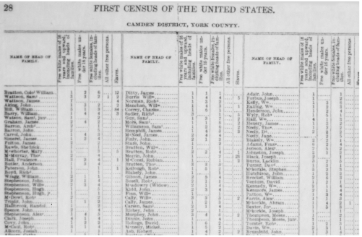


Funders Can Help Make the 2020 Census
Fair & Accurate
Gary D. Bass
Bauman Foundation
May 29, 2018

Slide 2
GOAL:
Fair & Accurate Census
OBJECTIVE:
Undercount not > than 2010
PLAN OF ACTION:
Policy Improvements
Expanding the Base of Census Stakeholders
Get Out The Count
Underway
Just Starting

Slide 3
WHO ARE THE FUNDERS?
Around 60 Funders
Access Strategies Fund
Albuquerque Community Foundation
Anonymous
Babcock, Mary Reynolds Foundation
Barr Foundation
Bauman Foundation
Berger Action Fund
Blandin Foundation
Bush Foundation
Butler Foundation
California Community Foundation
Carnegie Corporation
Casey, Annie E. Foundation
Casey, Marguerite Foundation
Claneil Foundation
Con Alma Health Foundation
Coulter Foundation
East Bay Community Foundation
Fels, Samuel S. Fund
Ford Foundation
Four Freedoms Fund
Fund for New Jersey
Gates, Bill & Melinda Foundation
Gold Bay Foundation
Grove Foundation
Heising-Simons Foundation
Hewlett Foundation
Hyams Foundation
Irvine Foundation
Joyce Foundation
JPB Foundation
Kellogg Foundation
Klarman Family Foundation
Knight Foundation
Latino Community Foundation
Maddox Foundation
McCune Foundation
Miller Foundation
Open Society Foundations
Philadelphia Foundation
Pittsburgh Foundation
Rhode Island Foundation
Robert Wood Johnson Foundation
Rockefeller Philanthropy Advisors
Roth Family Foundation
San Francisco Community Foundation
Santa Fe Community Foundation
Sapelo Foundation
Silicon Valley Community Foundation
Solidarity Giving
State Farm
Streisand Foundation
Sunlight Giving
Taos Community Foundation
Thornburg Foundation
Unbound Philanthropy
Wellspring Philanthropic Fund
WKF Giving Fund

Slide 4
WHO IS BEING FUNDED?
More than 70 Groups
ACCESS
Advancement Project
Akin Gump
American-Arab Anti-Discrimination Committee
Asian Americans Advancing Justice | AAJC
Atlas Project
Blueprint North Carolina
Census Policy Advocacy Network
Census Project
Children Now
Children's Defense Fund - Ohio
City University of New York
Color Of Change
Common Cause
Council for a Strong America
Ethnic Media Services
Faith in Public Life
Funders’ Committee for Civic Participation
Foraker Group
Forefront
George Washington Institute of Public Policy
Georgetown Center on Poverty and Inequality
Global Integral Solutions
Grantmakers Concerned w/ Immigrants & Refugees
Grantmakers for Southern Progress
Great NonProfits
Latino Community Foundation
Leadership Conference Education Fund
Management Assistance Group
Massachusetts Census Equity Fund 2020
Michigan Nonprofit Association
Minnesota Council on Foundations
NALEO Educational Fund
National Association of Counties
National Conference of State Legislatures
National Congress of American Indians
National League of Cities
National LGBTQ Task Force
National Neighborhood Indicators Project
National Urban League
NC Child
New America
New America Media
New Venture Fund
Nonprofit VOTE
NYS Council on Children and Families
O'Hare Data and Demographics Services
Pennsylvania Voice
PICO (Faith in Action)
Prison Policy Initiative
Public Private Partnership
San Francisco Study Center
Sant La
Southern Coalition for Social Justice
State Voices
U.S. Conference of Mayors
United Philanthropy Forum
UNM Geospatial and Population Studies
Urban Institute
USC Annenberg Data Integrity Project
Van Scoyoc Associates
Virginia Civic Engagement Table

Slide 5
ALIGNED FUNDING MECHANISM
Donors can give to either or both
Groups & Projects in Support of the
Plan of Action
Pooled Fund – 2020 Census Project – at New Venture Fund
All Grants Are Recorded in the Funding Tracker

Slide 6
WHAT ARE WE FUNDING NOW
Core Groups
Research
Communications
Outreach
Field
Funder
Biz & Tech
State/Local Govt Groups
General Activities
Census Counts Campaign
Evaluation
Pooled Fund
Hard-to-Count Map
Distribution of Fed Funds
Undercount Research
Influencer Project
California
New York
North Carolina
Ohio
Pennsylvania
Virginia
Opinion research
Ethnic & mainstream media briefings
Communications plan
Faith-Based

Slide 7
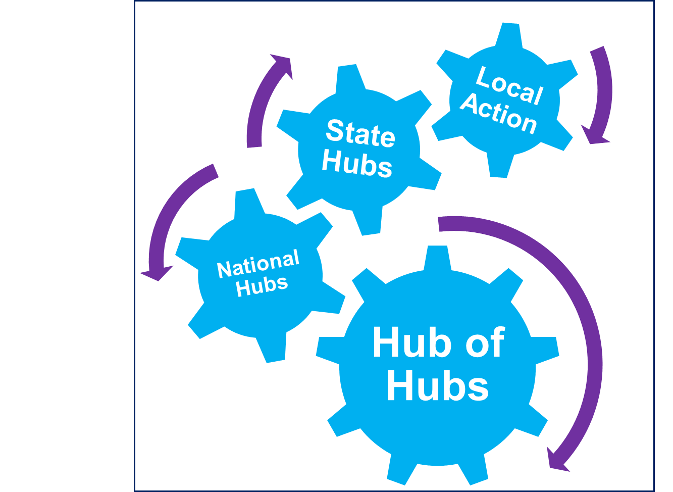
WHAT WE STILL NEED TO FUND
Developing culturally resonant messages
Create a network of expert national “hub” organizations
Encourage and assist in completion of census
Develop and conduct a media plan to support the GOTC campaign
Use technologies and analytics to identify and assist in completion of the census
Create a rapid response team and network
Get Out The Count Initiative

Slide 8
TOP PRIORITIES FOR 2018
Oppose Citizenship Question – litigation; public comment period; public persuasion; and legislative
2. Technology – monitor Bureau’s IT systems; build digital organizing capacity to reach Hard-to-Count
3. Communications – develop a plan & provide support for implementation; address mis/disinformation
4. GOTC – develop culturally resonant messages, begin to identify trusted voices, and collaborate with state/local government, nonprofits & businesses

Slide 9
BUSINESS OUTREACH
The “Asks”
Support organizations doing census work
Engage on census policy issues
Provide technical assistance (e.g., technology companies)
Help promote the importance of filling out the census
Encourage other companies to get involved in the census

Slide 10
3 THINGS YOU CAN DO
Commit to Engaging in Census – speak out on census; work with state/local officials on complete count committees; encourage other funders to participate; should there be a Western PA pooled fund?
Convene funders, stakeholders and business leaders – this is a collaboration; help identify trusted voices in the community
Provide support for census either through new grants or add-ons to existing grants – regardless of your funding priority support of the census will help you

Slide 11
WHAT FOUNDATIONS CAN DO
Private foundations can’t lobby w/out incurring a taxable expenditure. Charities, including community foundations, can w/out fines.
Lobbying is an attempt to influence legislation. Doesn’t include an attempt to influence an executive branch action, sue the government, or discuss broad policy issues (such as with the census).
Private foundations can support grantees that engage in lobbying.
Use general support grants or a project grant where the size of the grant is not greater than the non-lobbying portion of the project budget. It is vitally important that foundations refrain from including a prohibition on using their funds for lobbying in their grant award letters.
Private foundations can submit comments to Census Bureau and send non-lobbying information to grantees.
The Census Bureau will invite public comments in June on the 2020 census & the citizenship question. Private foundations may submit comments, sign on to other comments, fund groups to submit comments, and encourage others (such as elected officials) to submit comments.

Slide 12


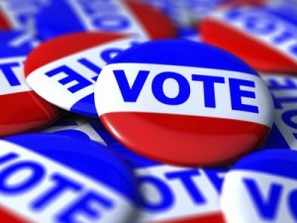

UNDERLYING STRATEGY
Funding census is helpful
Linking census to broader civic engagement is strategic
STRONGER TOGETHER
CENSUS

