Slide 1

Presented by
Date
Grantmakers Of Western Pennsylvania
March 30, 2015

Slide 2
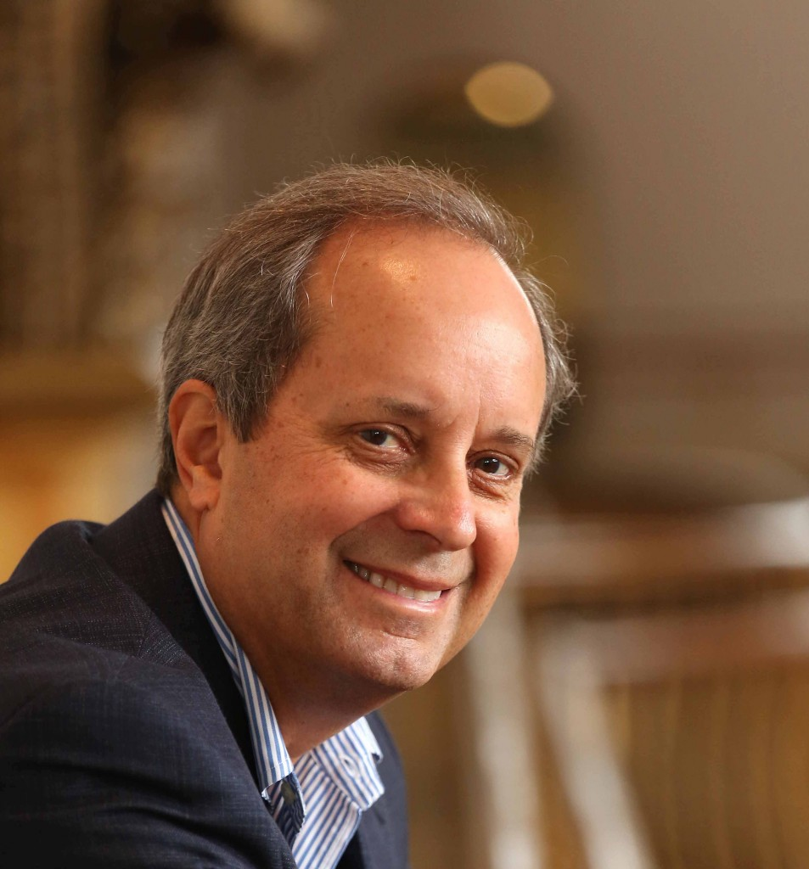
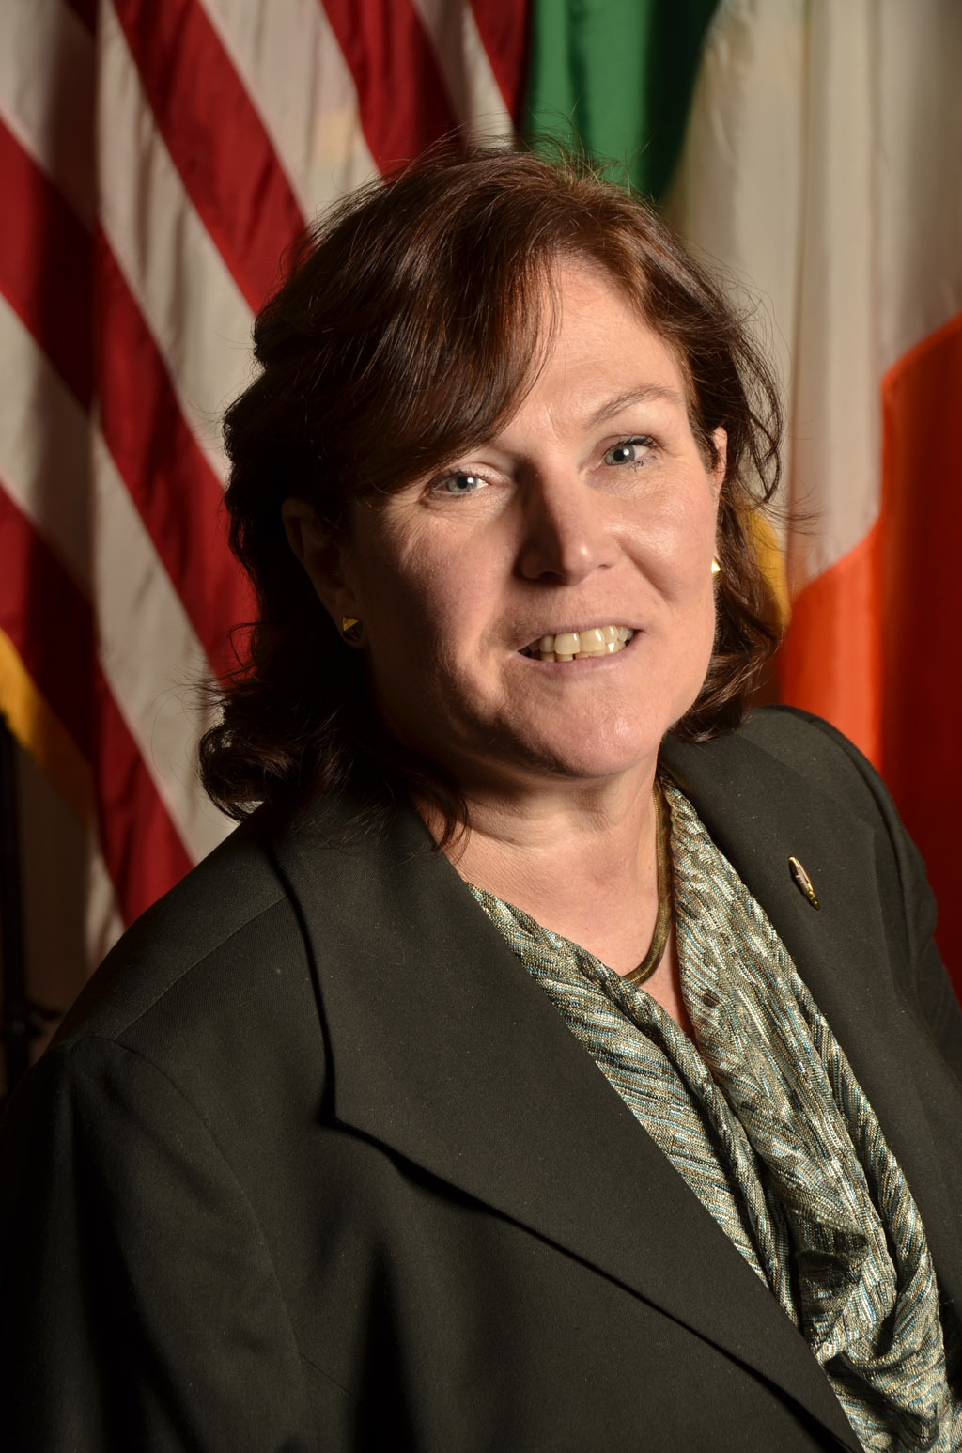

Today’s presenters
Robert G. Ottenhoff
President & CEO
Center For Disaster Philanthropy
Marion O’Neill
Manager, Corporate Contributions
PSEG

Slide 3
In today’s webinar:
The State of Disaster Philanthropy
What we can do better/differently
PSEG's approach to disaster response and preparation
Suggest ways you can manage your disaster giving
Afterward – we’ll take your questions

Slide 4
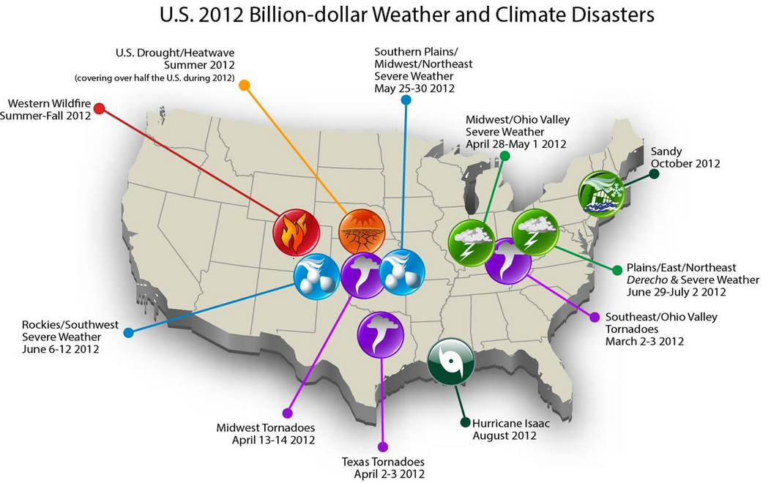
Why disaster philanthropy matters:

Slide 5
The good news
Americans Respond Generously:
9/11 Attacks = $2.8 billion
2004 South Asian Tsunami = $1.9 billion
2005 Hurricanes = $5.3 billion
2012 Haiti Earthquake = $3 billion
2012 Hurricane Sandy = $1 billion

Slide 6
But now, the not-so-good news
Disaster response tends to be…
    Uncoordinated
    Reactive
    Underfunded
    Forgotten
    Not Chronicled

Slide 7
The Center for Disaster Philanthropy
Our Mission
Transform the field of disaster philanthropy by increasing donor effectiveness throughout the full lifecycle of disasters

Slide 8
What We Do
Educate, Inform, and Engage
  Active, timely web site
  Media support
  Webinars and Appearances
  Social Media
Funds to help donors collaborate
Advisory services

Slide 9
The Disaster Life Cycle
To many, it looks like this:
Emergency Response & Relief
But that is only the beginning…

Slide 10
We Need to Move from Being Reactive to Strategic
Strategic
Reactive
Disaster Life Cycle
Resilience, Risk Reduction & Mitigation
Reconstruction & Recovery
Response & Relief
Preparedness

Slide 11
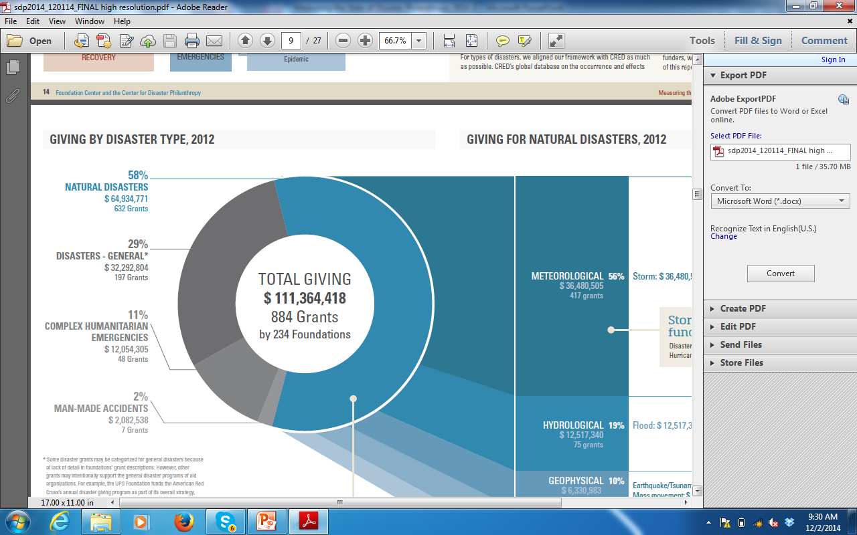
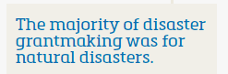
Part of Our Work is Learning Who’s Doing What
Baseline: Foundation Giving 2012
Sample = 1,000 of the largest U.S. foundations
Only grants of $10,000 or more
Total giving of these foundations = ~ half of total giving by all U.S. foundations in 2012
58%

Slide 12
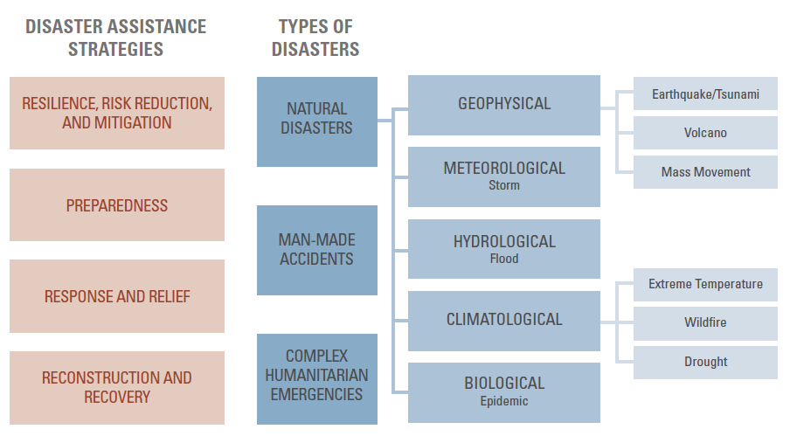
Baseline: Foundation Giving 2012
DISASTERS – GENERAL 29%
58%
2%
11%

Slide 13
Baseline: Foundation Giving 2012
DISASTERS – GENERAL 29%
10%
58%
56%
19%
2%
8%
11%
7%

Slide 14
Baseline: Foundation Giving 2012
DISASTERS – GENERAL 29%
10%
10%
58%
56%
4%
19%
2%
46%
8%
11%
7%
11%

Slide 15
UNSPECIFIED/OTHER 10%
MULTIPLE STRATEGIES 18%
DISASTERS – GENERAL 29%
10%
10%
58%
56%
4%
19%
2%
46%
8%
11%
7%
11%

Slide 16
One of our goals…
Is to use that information to help lead the way to better, more efficient and strategic grantmaking.
Strategic

Slide 17
PSEG
Emergency Preparedness and Response

Slide 18

PSEG
A diversified energy company headquartered in New Jersey, having business in Connecticut, Albany, Long Island and New Jersey.

Slide 19
Corporate Responsibility
Strengthening safety systems and building resilience within our communities
Post Sandy Lessons Learned
Communications
Integrated Approach with Operations
Effective VOADs

Slide 20



Emergency Preparedness
and Response will provide resources and strategies to families with children ages 2 to 5, as well as community organizations, to help prepare for emergencies and learn effective and comforting ways to respond when a disaster occurs.

Slide 21


Emergency Preparedness Components
Available in English and Spanish on desktop, tablet,
mobile, and print-ready files
Family Resource Guide will offer tips for parents to prepare families for possible emergencies, as well as activities that parents and caregivers can do with young children to help them be prepared in the event of an emergency.
Educator’s Guide will include information and activity ideas to help educators talk with children and their parents/caregivers about the importance of and strategies for preparing for emergencies and staying safe
Community Host Guide will provide helpful information an ideas for community organizations to incorporate Sesame Street and PSEG emergency preparedness materials into events
Let’s Get Ready Mobile App will focus on emergency preparation
d
21

Slide 22

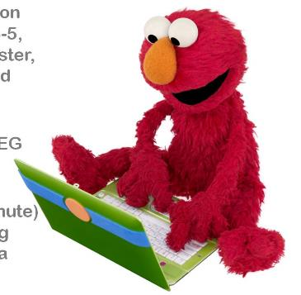
Emergency Response Components
Available in English and Spanish on desktop, tablet, mobile, and print-ready files
Family Resource Guide will include tips for parents how to explain disasters to children (2 or younger, 3 6-11), establish and maintain routines during a dis as well as strategies for helping children identify an manage their emotions during this difficult time.
PSEG and Community Partner Provider Guide will provide an overview of the key content and how PS and organizations may use the content with young children
(2 or younger, 3-5, 6-11) and families.
Family Comfort Moments will be three short (2-3 mi Muppet segments around asking questions, showin comfort, and coping with emotions. These will play role in helping families cope as they experience an emergency or disaster situation.

Slide 23
Thank You!
Next Steps to Creating a safety-focused culture
in our communities.
Deeper and Broader applications

Slide 24

What can you do?
Option 1:
Create your own response plan

Slide 25

What can you do?
Option 1:
Create Your Own Response Plan
Option 2:
Hire experts to help

Slide 26

What can you do?
Option 1:
Create Your Own Response Plan
Option 3:
Use outside managers to oversee response

Slide 27
Questions?

Slide 28
For more information, please contact:
Robert G. Ottenhoff, President & CEO
bob.ottenhoff@disasterphilanthropy.org

