Slide 1
Assessing Grantees’ Financial Health and Long-term Sustainability
Hilda Polanco, CPA, CCSA®, CGMA, Founder & CEO
John Summers, Director

Slide 2
Overview
Agenda
Welcome (9:00am)
Understanding Audited Financial Statements
OMB Uniform Guidance
Resources & Wrap Up
Adjourn (12:00pm)

Slide 3
Overview
What worries you when you think about
your grantees’ financial health?

Slide 4
Overview
What financial information do you request from grantees?
Audited financial statements
IRS Form 990
Budget
Board approved budget for the full organization
Budget for a specific project / program
Internal financial statements
Anything else?

Slide 5
Nonprofit Financial Health Assessment

Slide 6
Analysis Tool: IRS Form 990 Version

Slide 7
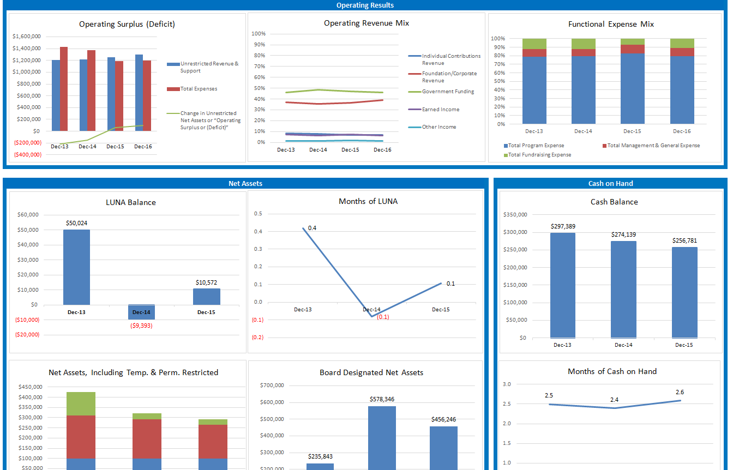
Tool Output: Trends Charts

Slide 8
Understanding Audited financial statements

Slide 9
Annual Financial Audit
Annual Financial Audit: Definition
A series of procedures followed by an independent professional accountant used to test, on a selective basis, transactions and internal controls in effect, all with a view to forming an opinion on the presentation of the organization’s financial statements

Slide 10
Annual Financial Audit
When is an Audit Required?
Rules vary by state. For Pennsylvania:
Nonprofits with annual contributions of $300,000 or above must undergo an audit
Nonprofits with contributions between $100,000 and$300,000, must file financial statements that are reviewed by a CPA
Nonprofits with contributions between $50,000 and $100,000 must have a compilation prepared by a CPA
See the National Council of Nonprofits’ Audit Guide for regulations for other states: www.councilofnonprofits.org/nonprofit-audit-guide

Slide 11
Introduction to Financial Statements
Order of statements in the audit
Statement of Financial Position (Balance Sheet)
Statement of Activities (Income Statement)
Statement of Functional Expenses (Required for Voluntary Health & Human Service Organizations)
Statement of Cash Flows
Management Letter

Slide 14
Audited Financial Statements: How the Numbers Flow
Statement of Activities
Statement of Financial Position
2
1
 | Year 2 |  | Year 1
 | Unrest | Temp | Unrest | Temp
Income | 315 | 100 | 35 | 30
Released from Restriction | 70 | (70) | 70 | (70)
Total Revenue | 385 | 30 | 105 | (40)
Expenses | 245 |  | 215
Change in Net Assets | 140 | 30 | (110) | (40)
Beginning Net Assets | 15 | 5 | 125 | 45
Ending Net Assets | 155 | 35 | 15 | 5
 | Year 2 | Year 1
Assets | 200 | 30
Liabilities | 10 | 10
Unrestricted Net Assets | 155 | 15
Restricted Net Assets | 35 | 5
Statement of Cash Flows
4
 | Year 2 | Year 1
Cash Flows from:
Operations | 230 | 205
Investing | (30) | 15
Financing | (30) | (200)
Change in Cash | 170 | 20
Beginning Cash | 30 | 10
Ending Cash | 200 | 30
Statement of Functional Expenses
Year 2 | Program | M&G | Fundraising | Total
Personnel | 80 | 25 | 15 | 140
OTPS | 75 | 25 | 25 | 105
Total | 155 | 50 | 40 | 245
3
Year 1 | Program | M&G | Fundraising | Total
Personnel | 90 | 25 | 15 | 130
OTPS | 40 | 30 | 15 | 85
Total | 130 | 55 | 30 | 215

Slide 16
Balance Sheet
What We Own:
Cash
Receivables
Investments
Property, Plant & Equipment, net
Assets
Liabilities
What We Owe:
Bills due
Line of Credit
Deferred Revenue
Long-term Debt
=
+
Net Assets
Our Available Capital
Unrestricted
Board Designated
Fixed Assets
Other
Temp. Restricted
Perm. Restricted

Slide 17
Capital Structure
LUNA / Working Capital
Short-term
Liquid Capital
Debt Repayment
Longer-term
Reserves
(may be board designated)
Facility Reserve
Accessibility
Growth & Innovation
Temp. Restricted Net Assets*
Donor restricted
capital
Endowment**
*To be accessed only if delivering on donor expectations
**Only earnings are accessible

Slide 18
Balance Sheet: Operating Reserves
Liquid Unrestricted Net Assets (LUNA)
The portion of unrestricted net assets that could be converted to cash relatively easily (may or may not include board designated funds, based on accessibility)
Funds available for purposes such as supplying working capital, guarding against downturns, and pursuing new opportunities
LUNA = Unrestricted Net Assets – (Fixed Assets – Mortgages)
Benchmark: LUNA sufficient to cover 3-6 months of operating expenses is generally consideredd healthy, but this depends on an organization’s business model, plans, and goals.

Slide 19
Measuring Liquidity (Level of Reserves)
Balance Sheet: Liquid Unrestricted Net Assets (LUNA)
Indicator
Calculation
Months of Liquid Unrestricted Net Assets
Liquid Unrestricted Net Assets
Average Monthly Expense

Slide 20
Measuring Liquidity (Cash)
Balance Sheet: Months of Cash on Hand
Indicator
Calculation
Months of Cash on Hand
Total Cash and Cash Equivalents
Average Monthly Expense
Months of Cash on Hand
Total Cash and Cash Equivalents
Average Monthly Expense – Noncash Items*
*Depreciation, bad debt expense, etc.
20

Slide 21
Statement of Activities
Organizational performance for the fiscal year
Revenues by type and restriction
Expenses broken out functionally
Fiscal year’s operating results (gains/losses)
Amount released from restrictions
Balance of Temporarily Restricted Net Assets being carried forward into the next fiscal year
Revenues released from restriction

Slide 22
To Statement of Activities

Slide 23
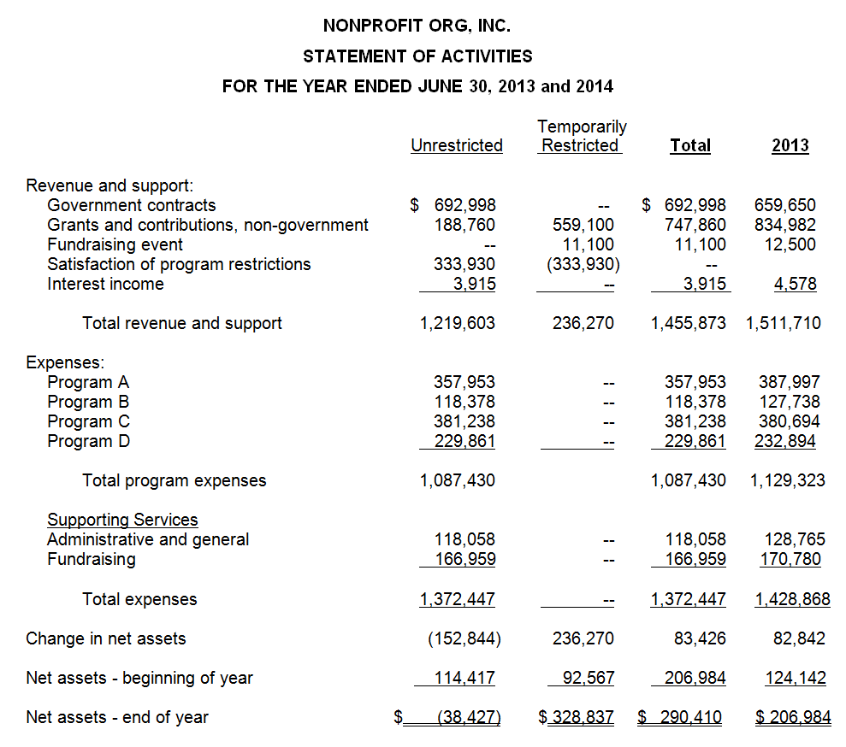
Operating
Results
TRNA balance going into the next fiscal year
Reserve
Balance

Slide 24
Operating Results
Statement of Activities: Operating Results
Indicator
Calculation
Operating Results
Unrestricted Revenue – Total Expenses

Slide 25
Financial Health Analysis Tool
Calculating Operating Results

Slide 26
Financial Health Analysis Tool
Calculating LUNA

Slide 27
Financial Health Analysis Tool
Calculating Months of Cash on Hand

Slide 28
To Stmt of Functional Expenses

Slide 29
Statement of Functional Expenses
Expense Analysis
What is the largest program?
Is the program with the largest expense a program aligned with the organization’s mission?
What is the largest expense?
Salaries and benefits are often an organization’s largest expense, usually making up 60% or more of total expenses

Slide 30
Statement of Functional Expenses
Defining an Organization’s Functional Expenses
Classification | Description | Examples
Program, separated by major programs | The direct provision of goods or services related to the organization’s mission and purpose | Program supplies, salaries of program staff
Support Services: Management & General | Activities such as oversight, business and financial management | Audit costs, salaries of Finance and HR staff
Support Services: Fundraising | Incurred in inducing donors to contribute | Costs to produce a donor event, salaries of fundraising staff

Slide 31
Largest Expense
Matches amounts on Statement of Activities
Largest Program
79.2%
8.6%
12.2%

Slide 32
Statement of Functional Expenses
Allocating Resources
Expense ratios: The percentage of funds spent by the organization in each functional area
Benchmark: Benchmark: Benchmark:
65%-70% 20%-25% 10%-15%
Program Expense
Total Expense
Mgmt. & General Expense
Total Expense
Fundraising Expense
Total Expense
Source BBB Wise Giving Alliance Charity Accreditation Standards:
http://give.org/for-charities/How-We-Accredit-Charities/
Notes:
BBB standard 8 says charities must “spend at least 65% of its total expenses on program activities”
It does not give specific recommendations regarding M&G and Fundraising percentages, other than that Fundraising must be less than 35%.

Slide 33
Nonprofit “Starvation Cycle”
Misleading reporting & Underinvestment
Unrealistic funder expectations
“The Starvation Cycle”
Pressure on nonprofits to conform
Taking Action to End the Nonprofit Starvation Cycle, The Bridgespan Group, Donors Forum Workshops, February 2011

Slide 34
Investment of Resources
Statement of Functional Expenses: Resource Allocations
Indicator
Calculation
Functional Expense Composition
Program Expense
Total Expenses
General & Administrative Expense
Total Expenses
Fundraising Expense
Total Expenses

Slide 35
Financial Health Analysis Tool
Calculating Resource Allocations

Slide 36
Statement of Cash Flows
Understanding the Statement of Cash Flows
Looks at where cash was obtained and spent
Reports on the following activities:
Operations
Investing
Financing
Must disclose any non-cash activity such as acquisitions of equipment on finance

Slide 37
To Stmt of Cash Flows

Slide 38
Matches cash amount on
Statement of Financial Position

Slide 39
Notes to the Financial Statements
Significant Disclosures
Description of the organization
Basis of accounting (cash, accrual and modified accrual)
Fixed assets
Debt
Temporarily and permanently restricted net assets
Related party transactions
Subsequent events
Commitment and contingencies

Slide 40
OMB Uniform guidance

Slide 41
Effective Dates
Effective dates: cost principles & administrative requirements
Nonprofits must implement administrative requirements and cost principles for all new awards and additional funding increments of existing awards made after December 26, 2014
Notes:
Existing NICRAs remain in power until they are due to be renegotiated based on old OMB Circulars.
- For new rules to apply, the NICRA Fiscal Year has to begin as the first full FY on 12/26/14 or later.
Example: Under old rules, use allowances were allowable as a part of depreciation cost principle and are still in effect post 12/26/14 until the NICRA is due to be re-negotiated
For new grant applications submitted before 12/26/14 that will be awarded post 12/26/14, you must comply with the uniform guidance (new rules)

Slide 42
Cost Principles
New rules on coverage of indirect costs
If a nonprofit does not have a negotiated indirect cost rate, it can elect to charge a de minimis 10% of modified total direct costs
Can be used indefinitely
Once elected, must be applied to all federal contracts or pass-through funds (until the organization decides to negotiate a rate)
Cannot be used in cases where a federal statute expressly caps the rate at which indirect costs can be reimbursed
Notes:
David Ashenfarb: If you have a negotiated indirect rate, you cannot apply the de minimis rate.
US DOL FAQ Document: If the subrecipient already has a negotiated rate with the Federal government, the negotiated rate must be used. It also is not permissible for pass-through entities to force or entice a proposed subrecipient without a negotiated rate to accept less than the de minimis rate. The cost principles are designed to provide that the Federal awards pay their fair share of the costs recognized under these principals. (See section 200.100(c).) Pass-through entities may, but are not required, to negotiate a rate with a proposed subrecipient who asks to do so.
(http://www.dol.gov/oasam/FAQs/FAQ-dcd.pdf)

Slide 43
Cost Principles
New rules on coverage of indirect costs
Pass-through entities (i.e. state and local governments) must now allow the subrecipient to:
Use the same indirect cost rate they have negotiated with the federal agencies, or
Negotiate a rate between the sub-recipient and pass-through entity, or
If a rate does not exist, use the de minimis 10% rate
Notes:
COFAR FAQ document: What if state / Pass-through-entity (PTE) provides to a sub-recipient both Federal & non-Federal funds, does the indirect rate application apply only to Federal funds or total funds? Answer: It would only apply to the Federal funds and not to state funds per terms and conditions of the award
COFAR FAQ document: What happens if a Pass-through entity does not honor the NICRA rate of the sub?
Under 200.331, the PTE must use the negotiated indirect rate of the sub.
If not, there are remedies that a Federal awarding agency can sanction the PTE under § 200.338 through § 200.342.
Report the matter to the agency IG overseeing your Federal award.
Make sure the sub-award agreement stipulates the use of your NICRA currently in effect.

Slide 44
Reforms to Audit Requirements
New single audit threshold
Increases from $500,000 to $750,000
Audit requirements are effective for fiscal years beginning on or after December 26, 2014. Effectively, for fiscal years ending:
December 31, 2015
June 30, 2016

Slide 45
Other Changes
Other key changes in the new regulations
Personnel time and effort reporting
Procurement guidelines
Program administration costs (can now be changed as direct)
Subrecipient monitoring
Conflict of interest
Focus on internal controls

Slide 46
Action Items for Your Grantees
Assess what makes sense for the organization
10% de minimis rate or negotiated indirect cost rate
Apply for a rate or advocate for 10% coverage
If the org chooses not to negotiate and indirect cost rate, it should ensure it gets the de minimis rate on all applicable contracts
Determine which contracts include federal funding
Adjust how costs are allocated to applicable contracts

Slide 47
What Funders Can Do
National Council of Nonprofits Urges Funders to:
Alert your grantees to the new guidance and the need to know and protect their right to being reimbursed for indirect costs at a rate of at least 10%
In cases where grantees need to establish stronger cost allocation systems to be able to comply with the new guidelines, provide funding for professional development and systems improvements
Help the sector to engage in broader advocacy efforts so pass-through entities (i.e. state and local governments) fully comply with the new rules

Slide 48
Resources

Slide 49
Resources
The Key to Long Term Financial Health Liquid Unrestricted Net Assets (LUNA), Hilda Polanco, New York Nonprofit Press, May 2012: http://www.nynp.biz/index.php/strengthening-nonprofits/10505-the-key-to-long-term-financial-health-liquid-unrestricted-net-assets-luna-
Operating Reserve Policy Toolkit for Nonprofit Organizations: Whitepaper, the National Center for Charitable Statistics, Dec. 2008 http://www.nccs2.org/wiki/images/3/3c/OperatingReservesWhitePaper2009.pdf
The overhead myth website: http://overheadmyth.com/
Nonprofit audit guide: https://www.councilofnonprofits.org/nonprofit-audit-guide
Resources from the National Council of Nonprofits on the Uniform Guidance: https://www.councilofnonprofits.org/omb-uniform-guidance

Slide 50
Resources for Your Grantees
StrongNonprofits.org
In collaboration with the Wallace Foundation, FMA has created a library of tools and resources to help organizations become “fiscally fit”
Four Topic Areas: Planning | Monitoring | Operations | Governance

Slide 51
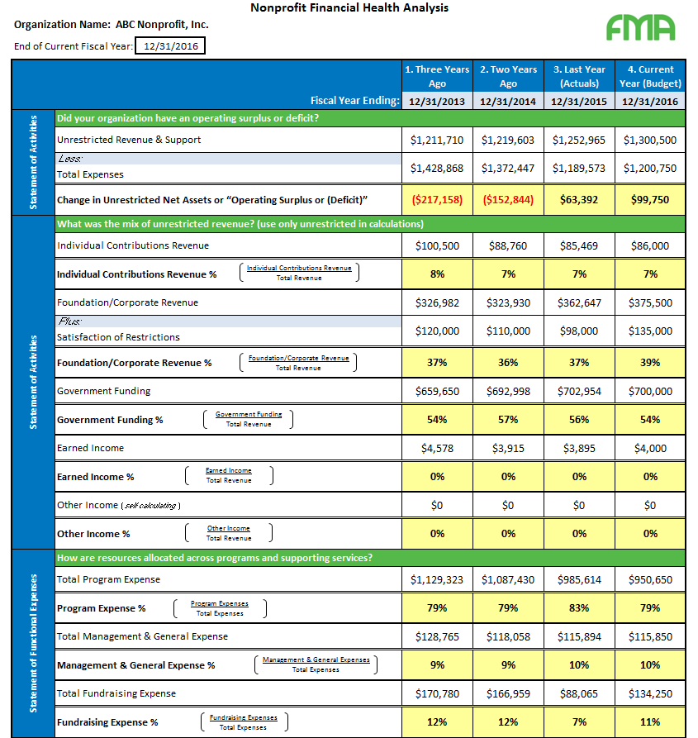
Resource: Financial Health Analysis Tool
Excel Tool for Audits & 990
Coming Soon: Online Tutorial on www.strongnonprofits.org

Slide 52
Resources for Your Grantees
Online Tutorials for StrongNonprofits.org
FMA offers complimentary orientation one-hour webinars that feature an overview of the website and drill down on several of its key resources
Upcoming webinar dates:
February 18 at 2:00pm
April 20 at 3:00pm
To register, or see upcoming webinar dates:
http://fmaonline.net/strongnonprofits
For a 15-minute, on-demand webinar tour
of the site:
http://fmaonline.net/SNPonDemand

Slide 53
Questions?

Slide 54
Fiscal Management Associates, LLC
Established in 1999 to serve not-for-profit organizations around the country
Provides customized financial management, accounting, software, organizational development, human resources, and other consulting services
Works directly with organizations or through funder-supported management and technical assistance programs
FMA's mission is to empower not-for-profit organizations with the knowledge and skills to successfully serve their constituents and fulfill their missions
Hilda Polanco, CPA, CCSA®, CGMA
hpolanco@fmaonline.net
John Summers
jsummers@fmaonline.net
New York | Chicago | San Francisco | LA
@FMA4Nonprofits
/FiscalManagementAssociates
linkedin.com/company/fiscal-management-associates-llc
www.fmaonline.net

