Slide 1
PA is READY! Administrative Relief Funders Briefing
Notes:
Introduction and opening – 5 min, Ana Lisa

Slide 2
About this webinar:
This webinar is being recorded.
During this webinar, all participant lines will be muted.
There will be several breaks throughout the program for questions, we ask that you type your questions into the chat box. You are also welcome to type questions throughout the presentation.
Due to time limitations, if we do not get to address your question during the webinar, we will follow up on your question via email.

Slide 3
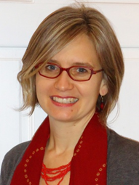
Presenters
Moderator
Ana Lisa Yoder
Director of Grantmaking and Special Projects
The Philadelphia Foundation
Sundrop Carter
Executive Director
PA Immigration and Citizenship Coalition

Slide 4
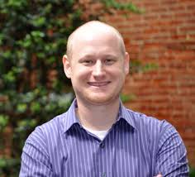
Presenters
Althea Gonzalez
Project Manager
Grantmakers Concerned with
Immigrants and Refugees
David Koser
Program Officer
Lancaster County Community Foundation

Slide 5
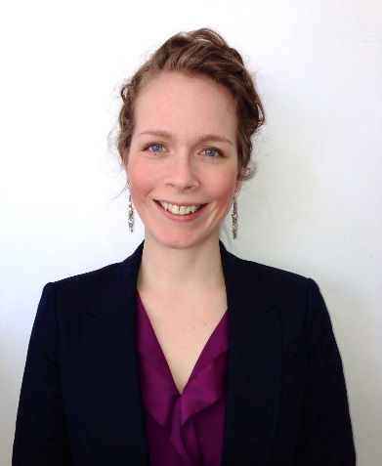
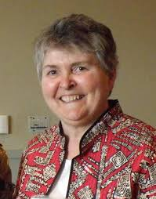
Presenters
Vanessa Stine
Equal justice Works Fellow
Friends of Farmworkers
Sister Janice Vanderneck
Director
Casa San Jose

Slide 6
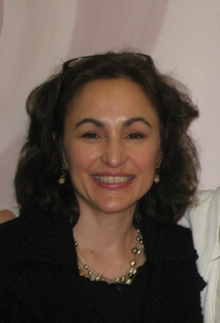
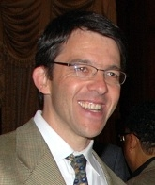
Presenters
Mary Weaver
Executive Director
Pennsylvania Immigration Resource Center
Philippe Weisz
Managing Attorney
HIAS Pennsylvania

Slide 7
Presenters
Bethany Welch
Executive Director
Aquinas Center
Notes:
Polls- who is on the call
Why did you chose to join today?

Slide 8
NATIONAL CONTEXT
Althea Gonzalez
Grantmakers Concerned with Immigrants and Refugees
Notes:
National context – 5-8 minutes

Slide 9
Demographics and Workforce
One quarter of all people in the U.S. are 1st or 2nd generation immigrants.
16.5%
13.1%

Slide 10
Poverty, Health, and Education
Nearly 50% are limited English proficient
More than
18% of immigrants are living in poverty
More than half (52.7%) have a high school degree or less
One-third are uninsured

Slide 11
Children, Families, and Communities
25% of all children in the U.S. have at least one foreign-born parent
85% of immigrants are in “mixed status” families
72% of foreign-born population has resided in the U.S. for 10 years+

Slide 12
2015: 12 Collaboratives in 9 States
OR
NY
IL
CA
CO
TN
NC
AZ
AR
TX
FL
Statewide
Major Metros Only
Major Metros & Statewide

Slide 13
Inform funders of the latest issues and trends and their relevance for philanthropy
Connect immigration to funding priorities and promote peer learning
Catalyze philanthropic response, especially collaboration

Slide 14
LOCAL CONTEXT
Sundrop Carter
PA Immigration and Citizenship Coalition

Slide 15
Local Need / Opportunity
Growth/demographics of immigrant & undocumented communities in Pennsylvania
Economic benefits of immigrant communities
Lack of services outside Philadelphia
Access to quality immigration services for existing forms of relief
Combating “notario” fraud
Notes:
3 min - Sundrop

Slide 17
POLICY CONTEXT
Philippe Weisz
HIAS Pennsylvania

Slide 18
Policy Context
2012 Deferred Action for Childhood Arrivals (DACA)
Approximately 665,000 have applied nationally
59% obtained a new job, 45% increased job earnings, 57% obtained a driver’s license, 49% opened their first bank account, and 21% obtained health care
Approximately 4,660 applied in PA
Summary of President Obama’s Executive Action on Immigration
On November 20, 2014, President Obama announced executive action on immigration. The President is directing federal immigration agencies to prioritize use of resources and:
Defer deportation and permit noncitizens to remain in U.S for period of time
Authorize work permits
Allow travel
Notes:
5 min - Philippe

Slide 19
Policy Context Cont.
What did this announcement do?
Expand Deferred Action to include parents of U.S. citizens and green card holders (DAPA)
Expand DACA to eliminate age cap, change date-of-entry, and extend EAD period to 3 years (DACA +)
End Secure Communities
Where is DAPA/DACA+ now?

Slide 20
Questions?
Notes:
5 min – Ana Lisa to moderate

Slide 21
About PA is Ready!
Diverse coalition of organizations across Pennsylvania formed in September 2014 to prepare for Executive Action on immigration
Includes grassroots community groups, legal service providers, faith communities and other nonprofit organizations
Works in close partnership with additional key stakeholders including local governments, Consulates, educational institutions, pro bono attorneys, unions, and businesses
http://www.paimmigrant.org/paisready
Notes:
10 min total
Sundrop – 2 min

Slide 22
PA is Ready! Members
Aquinas Center (Philadelphia)
CASA (York)
Casa de la Cultura (Gettysburg)
Casa San Jose (Pittsburgh)
Catholic Charities (Harrisburg)
Ceiba (Philadelphia)
Centro de Apoyo de Upper Darby (Upper Darby)
Church World Service – Lancaster (Lancaster)
Coalition of African Communities (AFRICOM) (Philadelphia)
Community Justice Project (Reading)
Esperanza Immigration Legal Services (Philadelphia)
Friends of Farmworkers (statewide)
Greater Reading Immigration Project (Reading)
Grupo de Apoyo e Integración Hispanoamericano (Allentown)
HIAS Pennsylvania (Philadelphia)
JUNTOS (Philadelphia, Norristown)
Lucha Pro Licencias (statewide)
Nationalities Service Center (Philadelphia)
New Sanctuary Movement of Philadelphia (Philadelphia)
Pennsylvania Immigration and Citizenship Coalition (PICC) (statewide)
Pennsylvania Immigration Resource Center (PIRC) (York)
St. Rocco Church (Avondale)

Slide 23
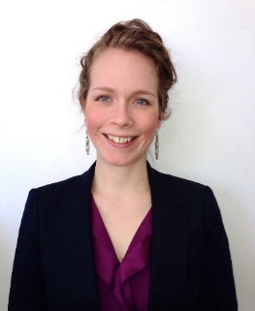
PA is Ready! Model
Sister Janice Vanderneck
Casa San Jose
Bethany Welch
Aquinas Center
Vanessa Stine
Friends of Farmworkers
Mary Weaver
PA Immigration Resource Center

Slide 24
PA is READY! Model: Principles
Build community leadership and volunteers
Build organizing capacity
Prevent immigration fraud
Reach diverse communities
Encourage collaboration
Notes:
Bethany & Sister Janice (?) – 3 min

Slide 25
PA is READY! Model: Goals
Build statewide capacity to provide immigration assistance
Citizenship, U-Visas, VAWA, 2012 DACA, etc.
Using low cost/high volume/high success model
Prevent the exploitation of immigrants through immigration services fraud
Build immigrant leadership and organizing capacity to engage local, state and federal immigrant rights advocacy
Screen and enroll as many eligible immigrants in DACA+/DAPA as possible once the application process opens
Reach the diverse immigrant communities in Pennsylvania
Notes:
Vanessa & Mary – 5 min

Slide 26
PA is READY! : Roles
Coordination
Lessons Learned from DACA implementation
Technical Assistance/Training
Services
Outreach/Community Education
Documentation Preparation Assistance and Screening
Assessment for forms of relief
Application Assistance
Pro Bono Legal Clinics & Services
Legal Representation
Referrals
Other Integrated Services: ITIN, tax preparation, asset-building
Notes:
5 min – Sundrop, Vanessa & Philippe

Slide 27
Questions?
Notes:
5 min – Ana Lisa to moderate

Slide 28
What Funders Can Do
Talk with your board and staff about why immigration is relevant to your community.
Offer to host an educational session for funders in your area.
Learn more about the issues through Grantmakers Concerned with Immigrants and Refugees. https://www.gcir.org/
Reach out to local providers to understand what’s happening in your community.
Help leverage national funding through PA is READY! Fund established at The Philadelphia Foundation. Contact: Ana Lisa Yoder, ayoder@philafound.org.
Notes:
PA is READY! Grantmaking Committee will redistribute grants to build the capacity of community based organizations and legal providers across the state.

Slide 29
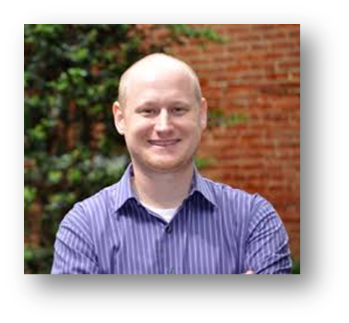
Why we supported this effort
David Koser
Program Officer
Lancaster County Community Foundation

Slide 30
Questions?
Notes:
5 min – Ana Lisa to moderate

Slide 31
Special thanks to…

